Slide 1


Figure 1
HMMER
ClustalO
Phylo Trees
NCBI/JGI
BLAST
Dataframe
Results
BUSCO
DIAMOND
Graphs
Primary
Literature

Slide 2
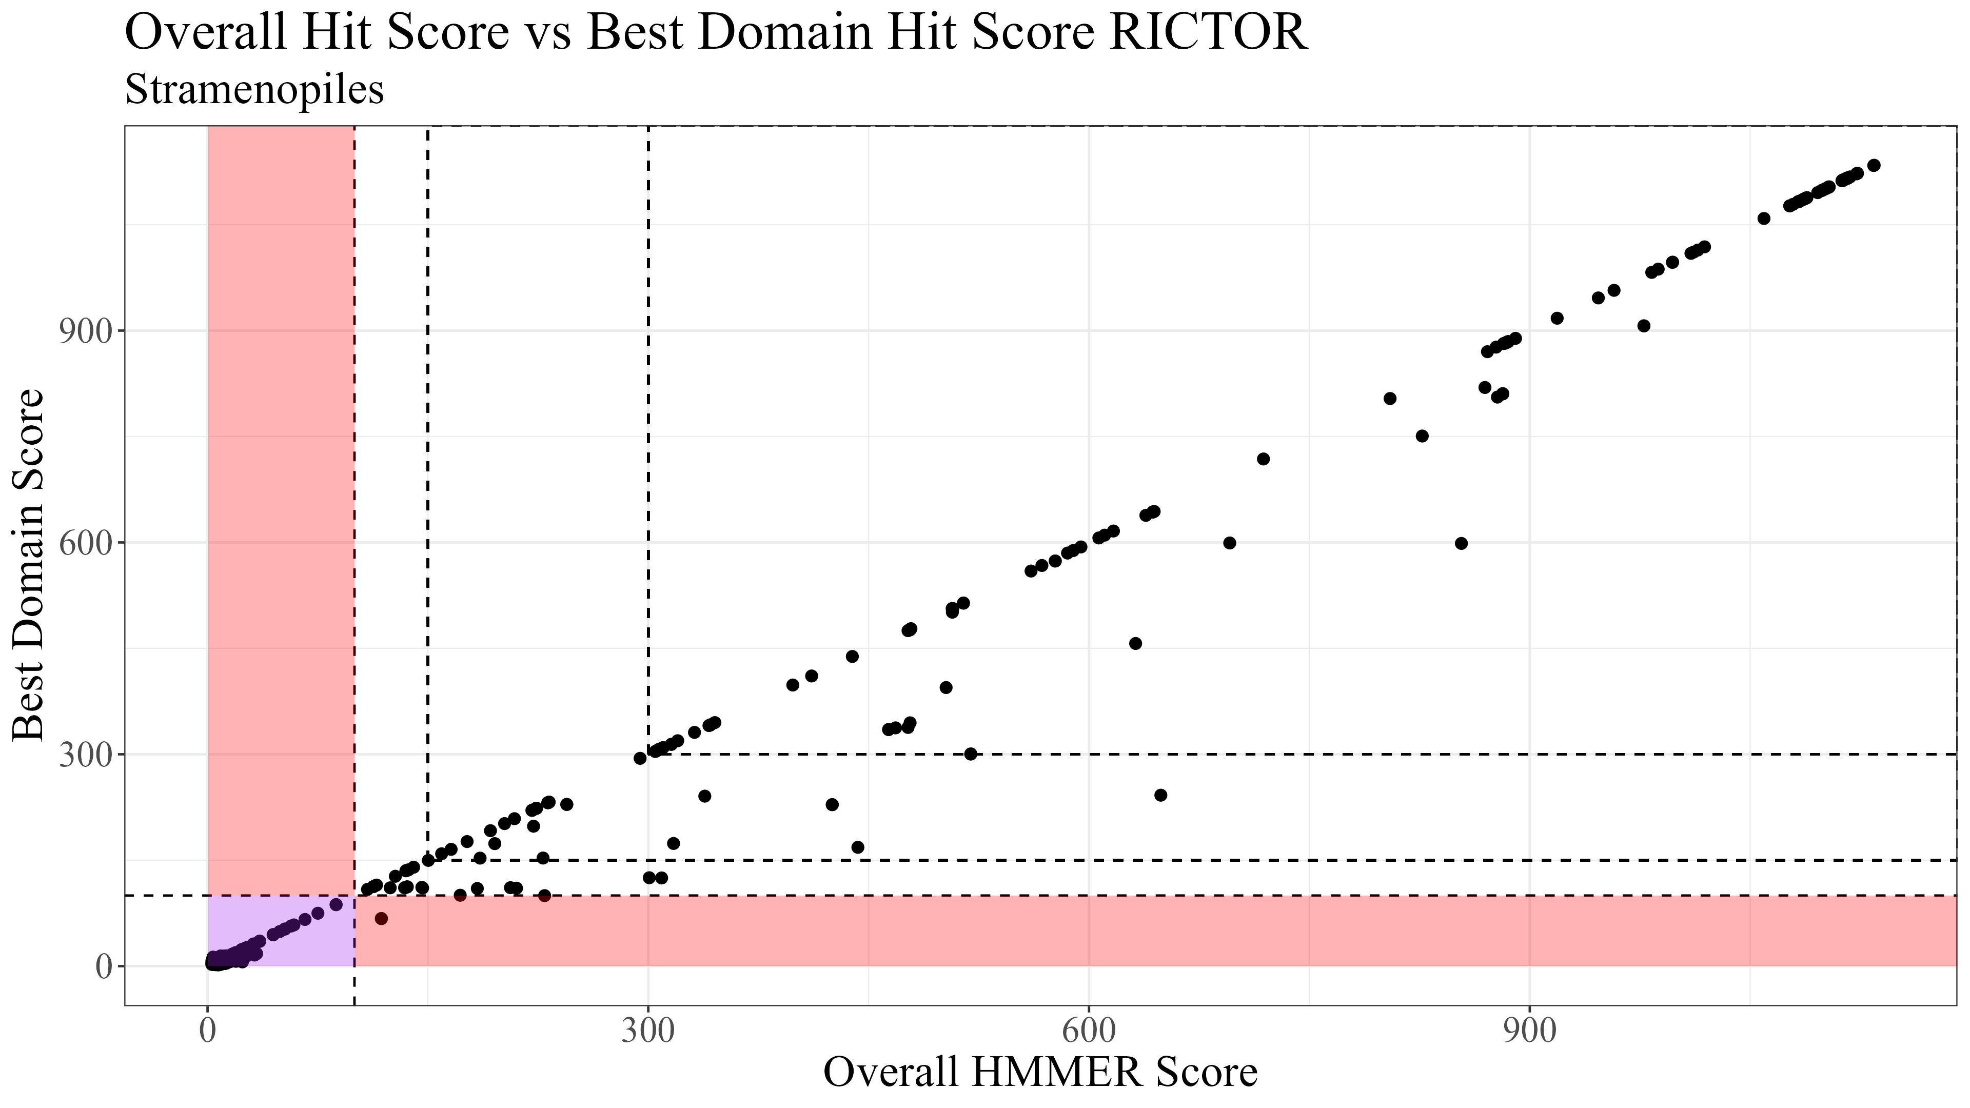
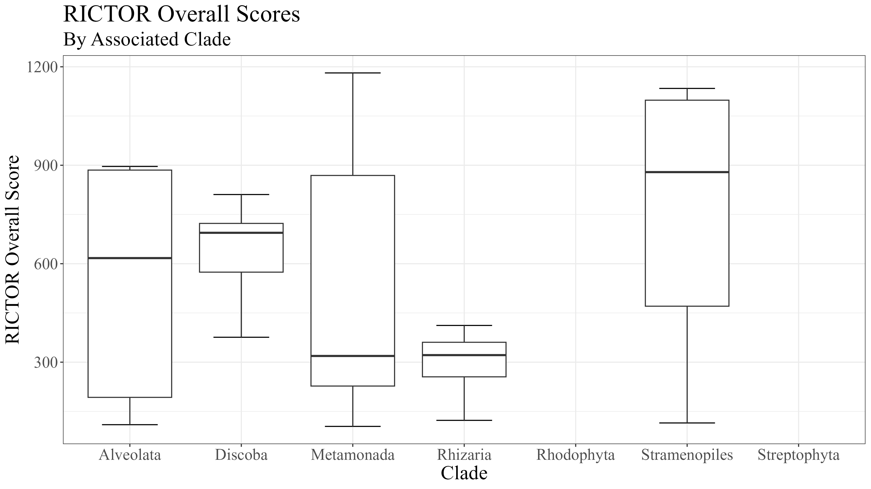
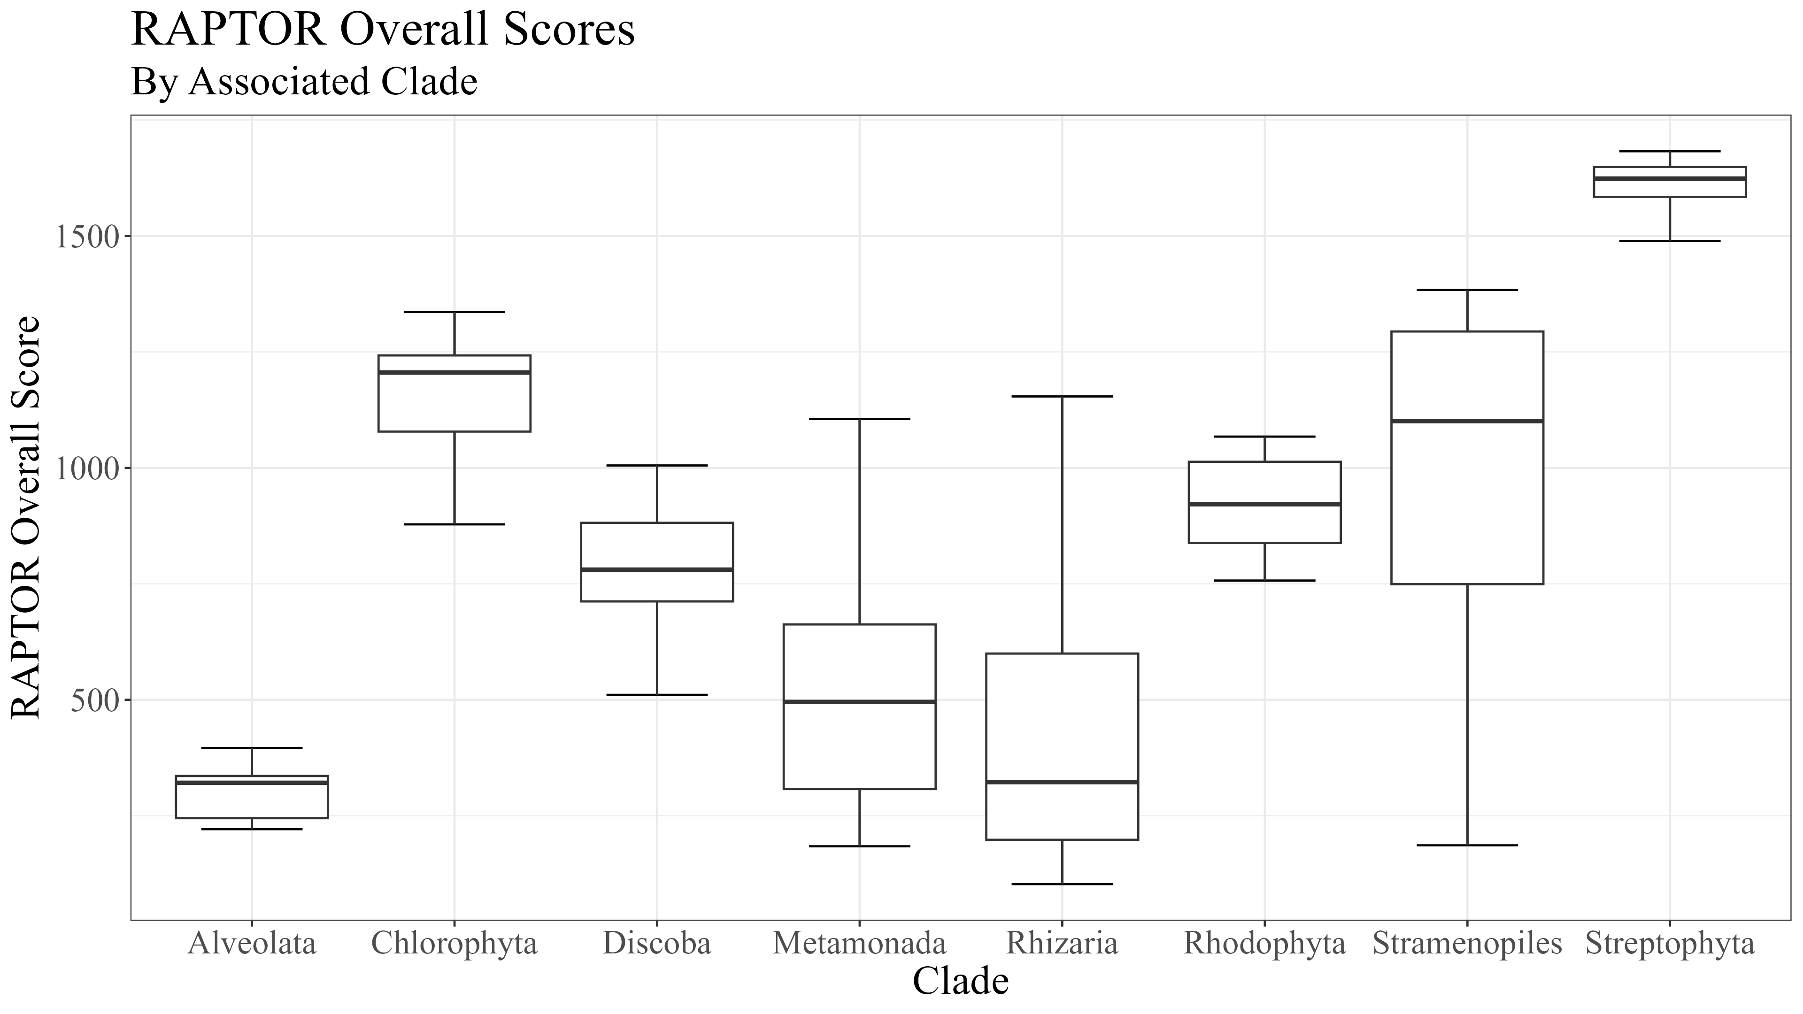
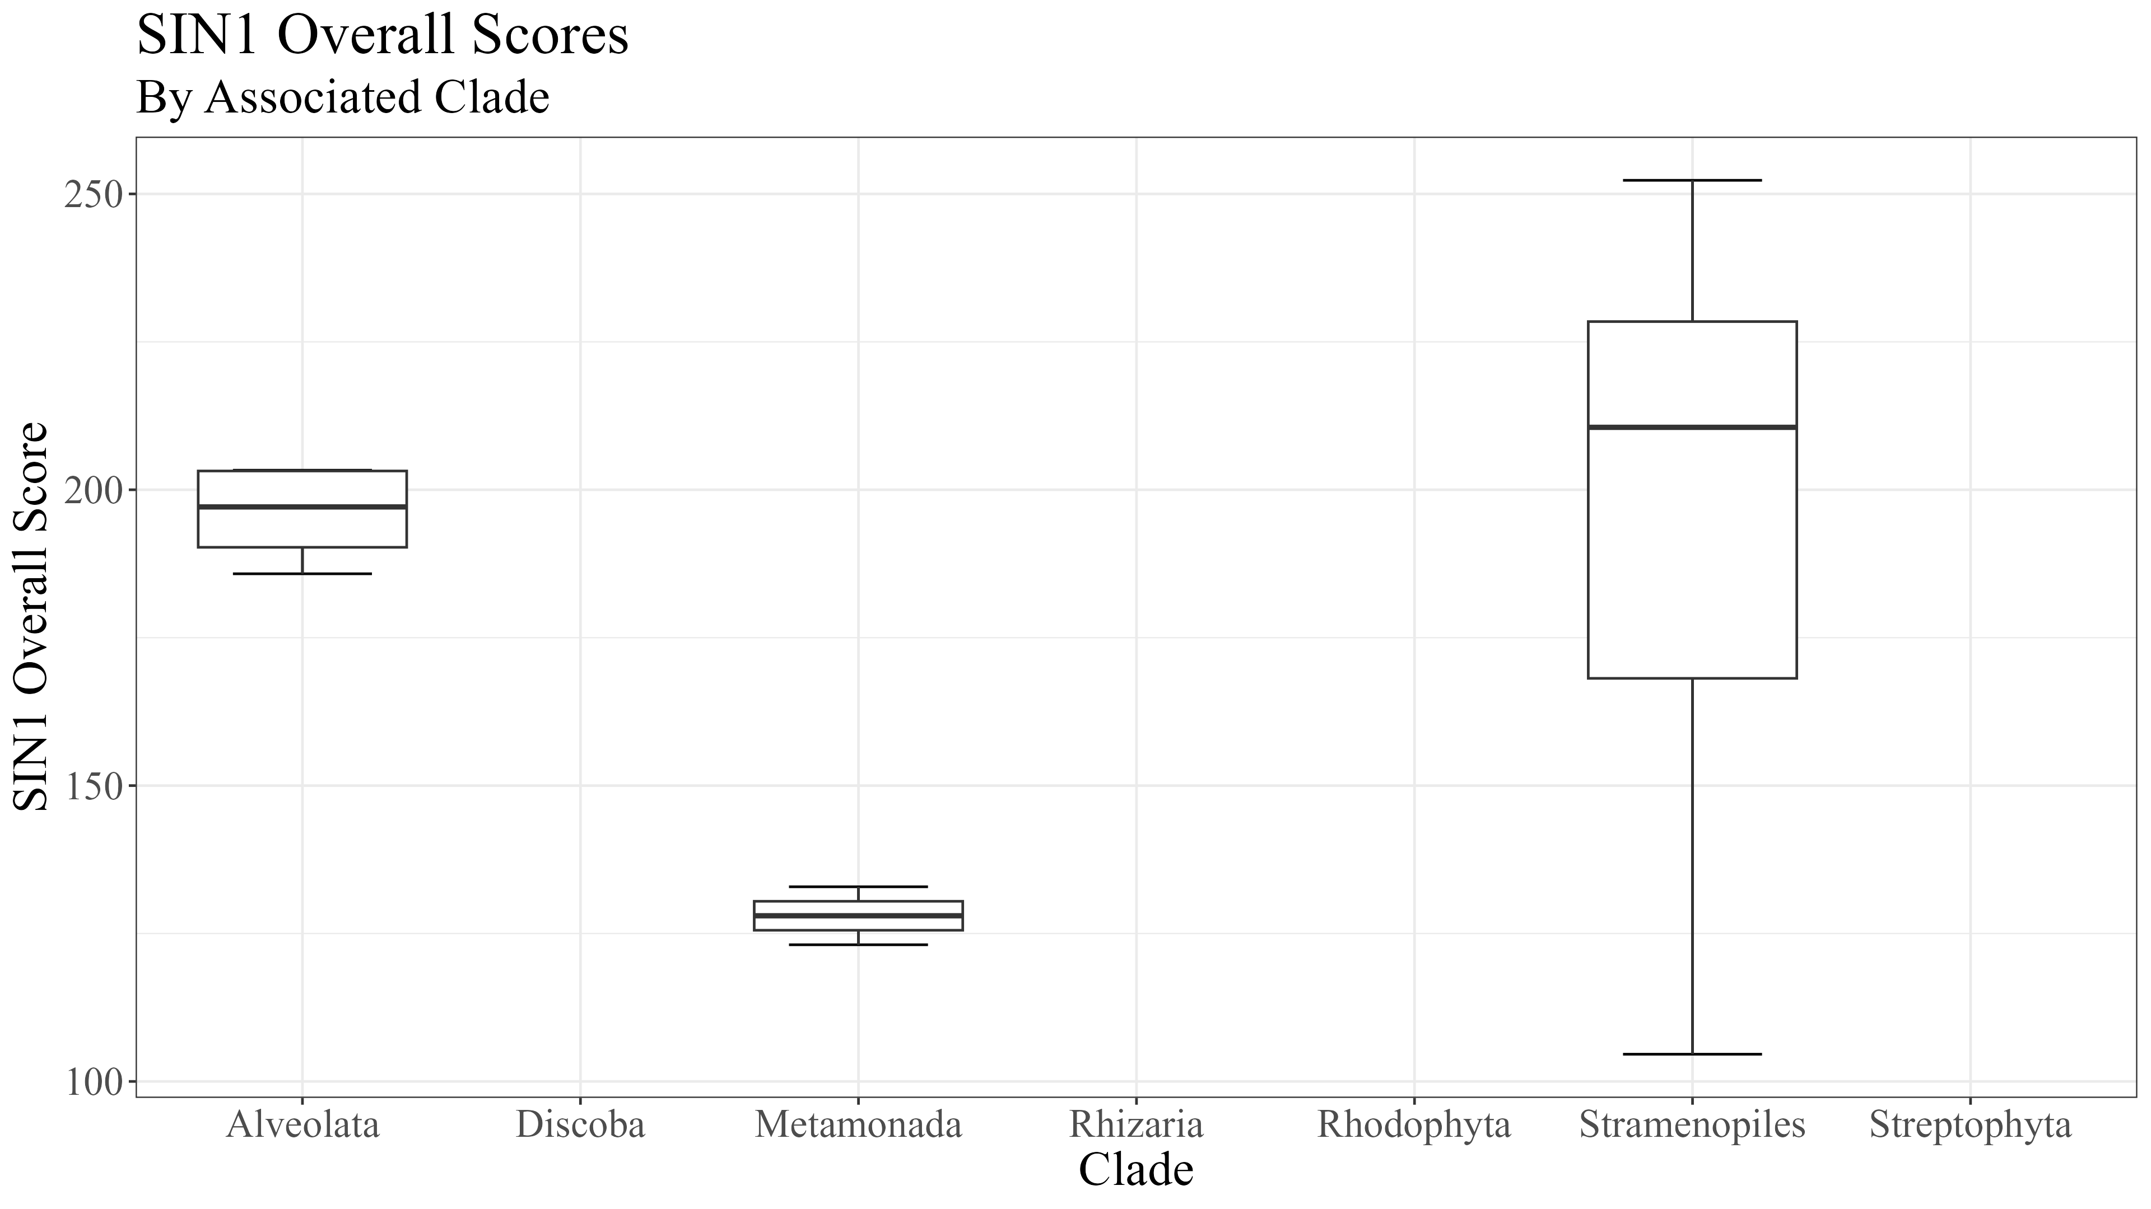
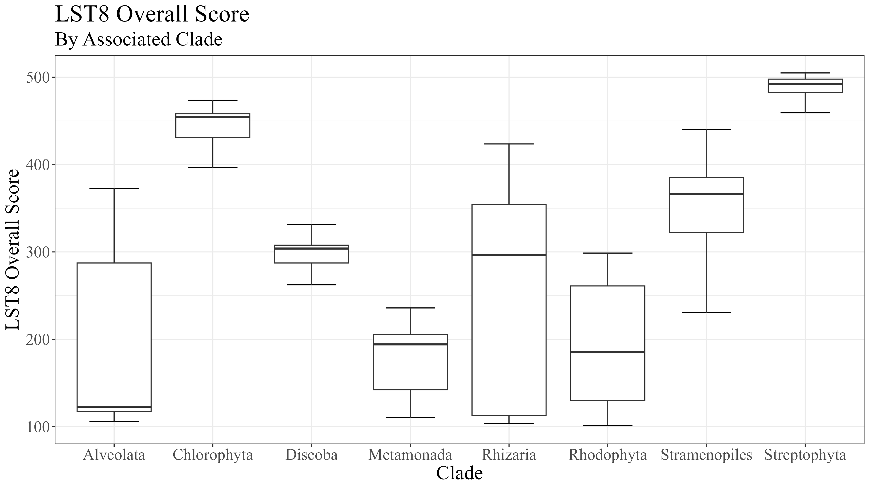
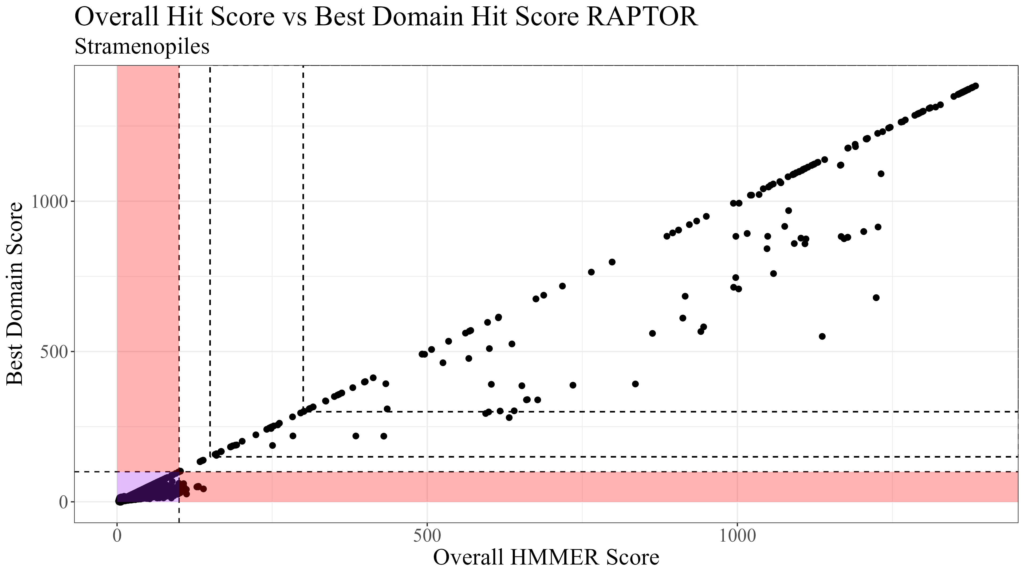
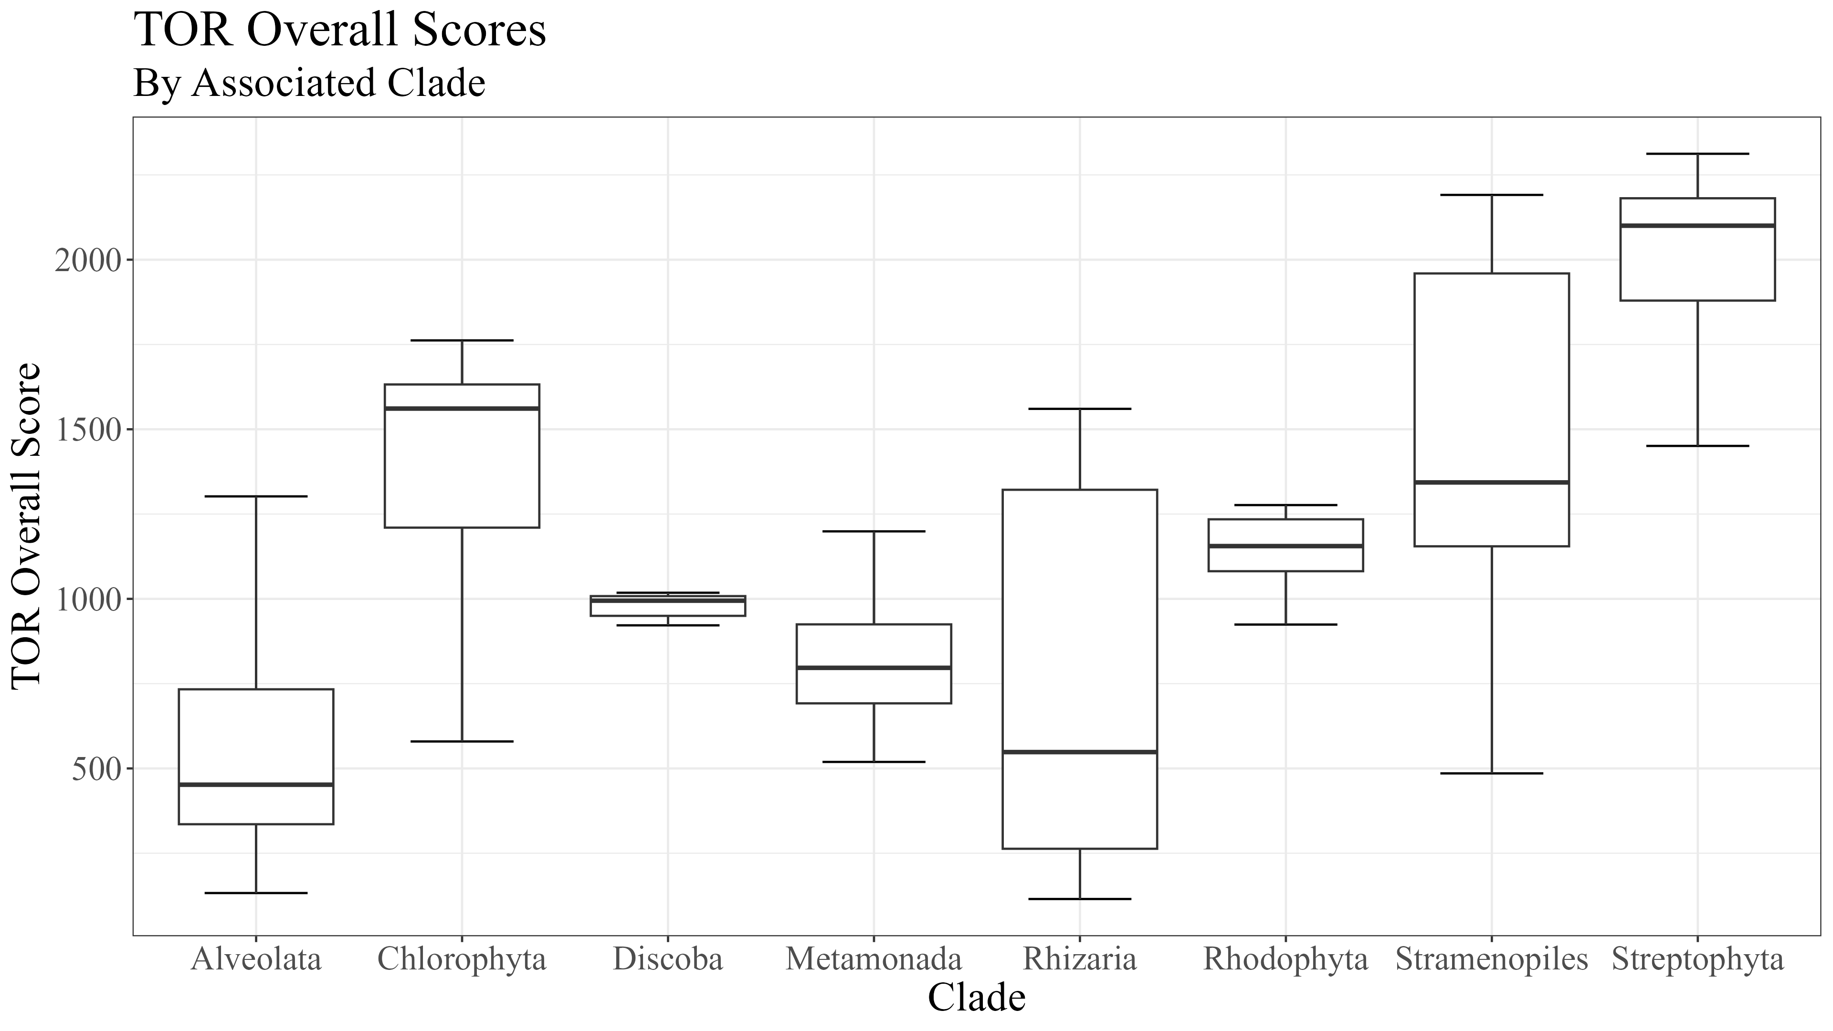
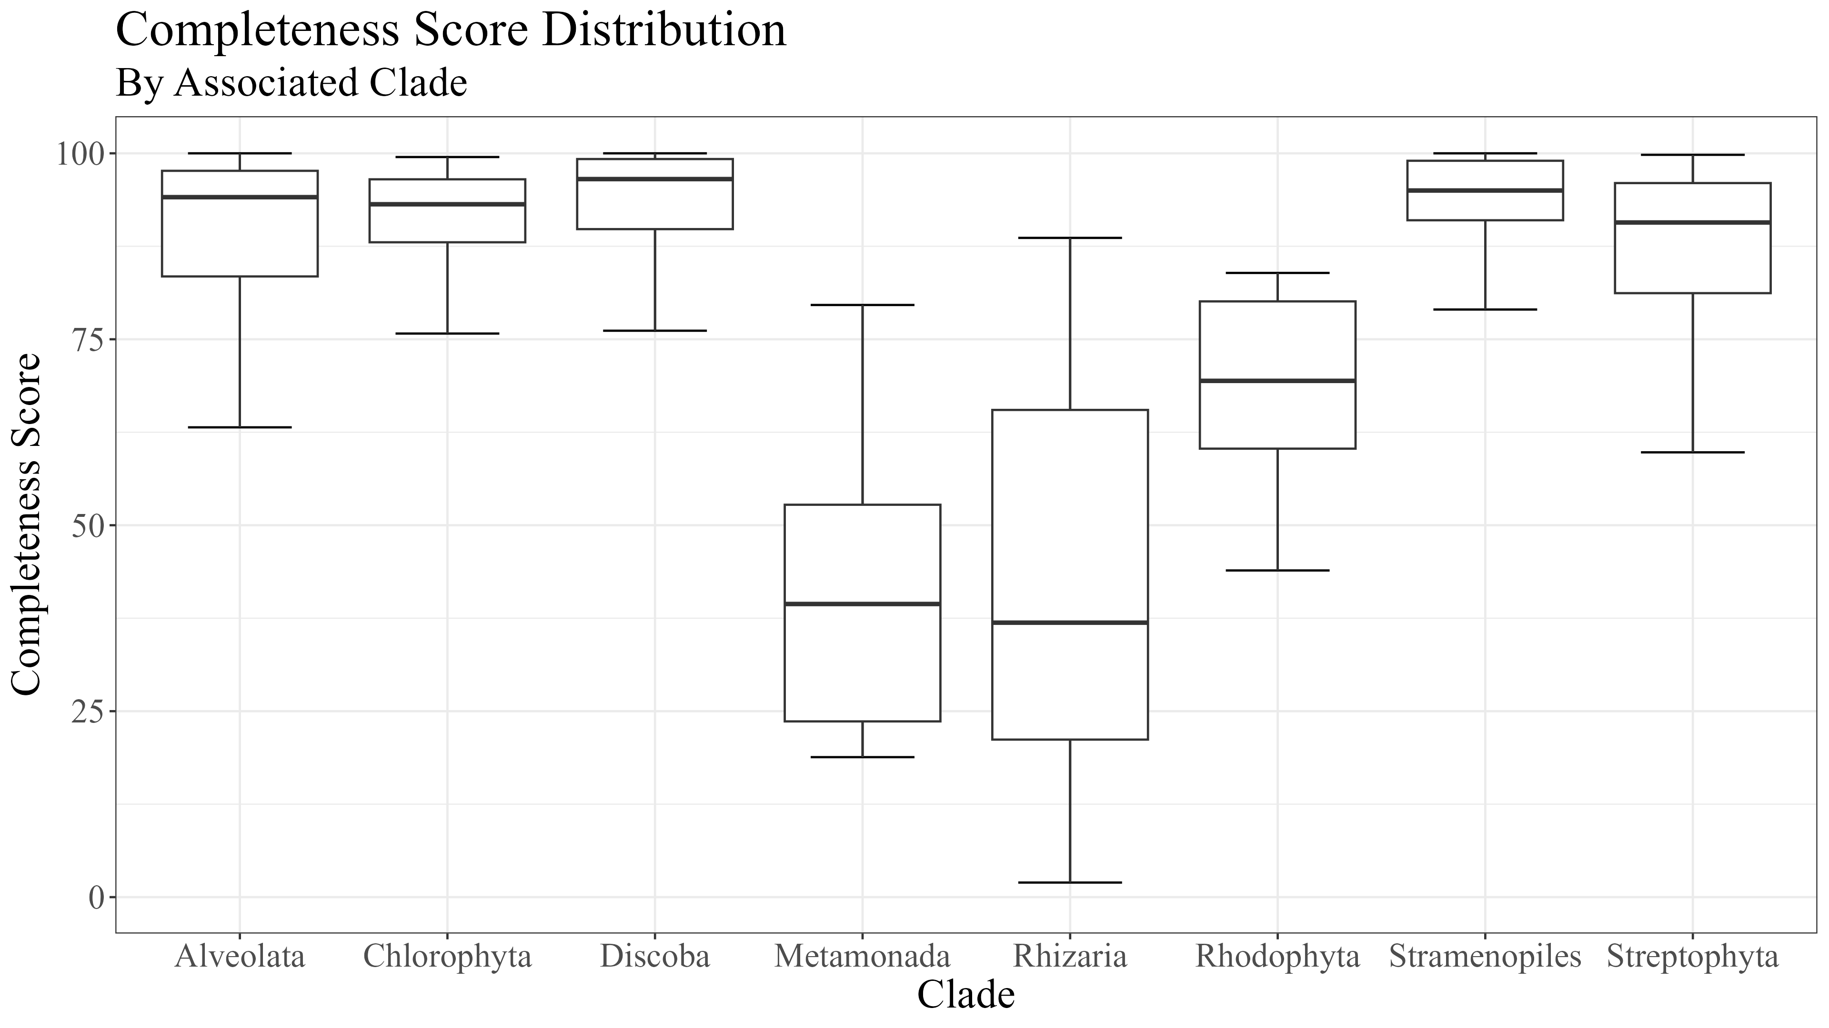
Figure 2

Slide 3




Figure 3
RICTOR
RAPTOR
N
N
RICTORN
RAPTORN
Reference
Reference
High
RICTORM
ARM
High
Medium
RasGEF
HEAT
Low
Medium
Dom5
ARM
Reference
Reference
RICTOR
Phosphor
WD-40
High
High
Medium
Medium
Low
C
C

Slide 4
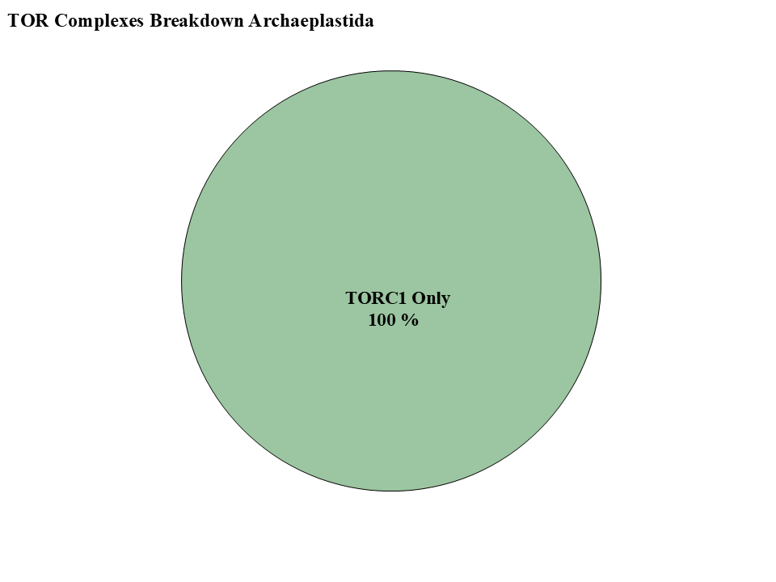
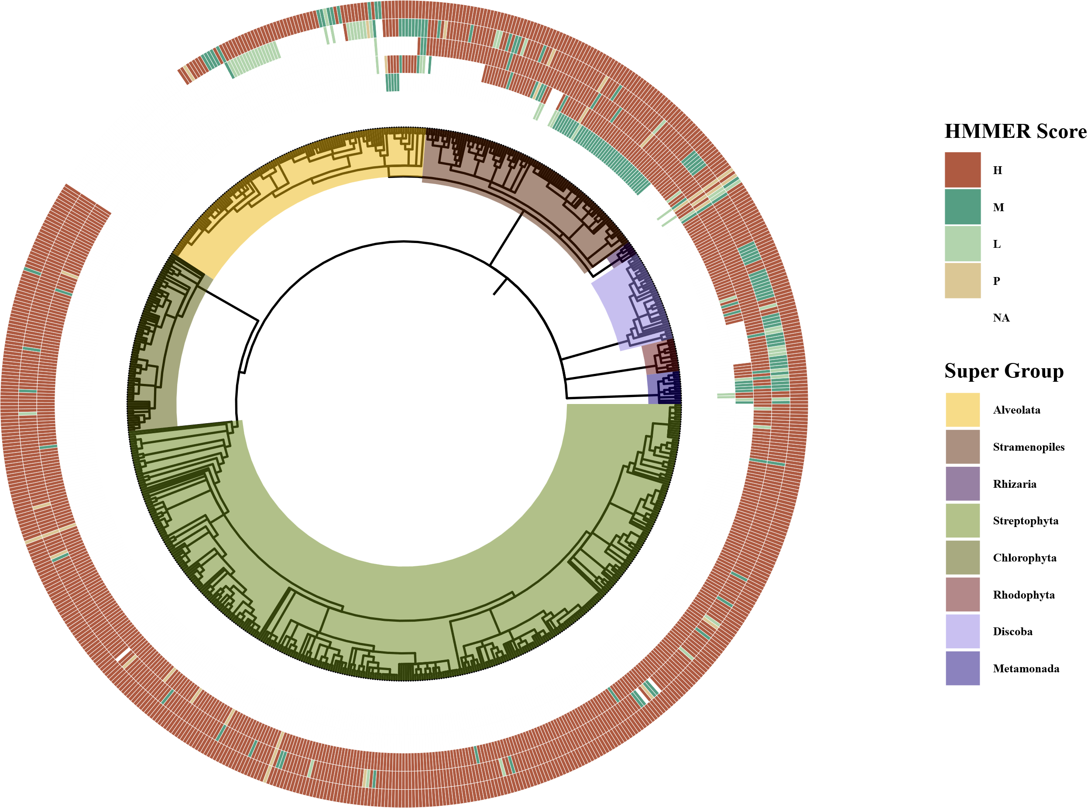
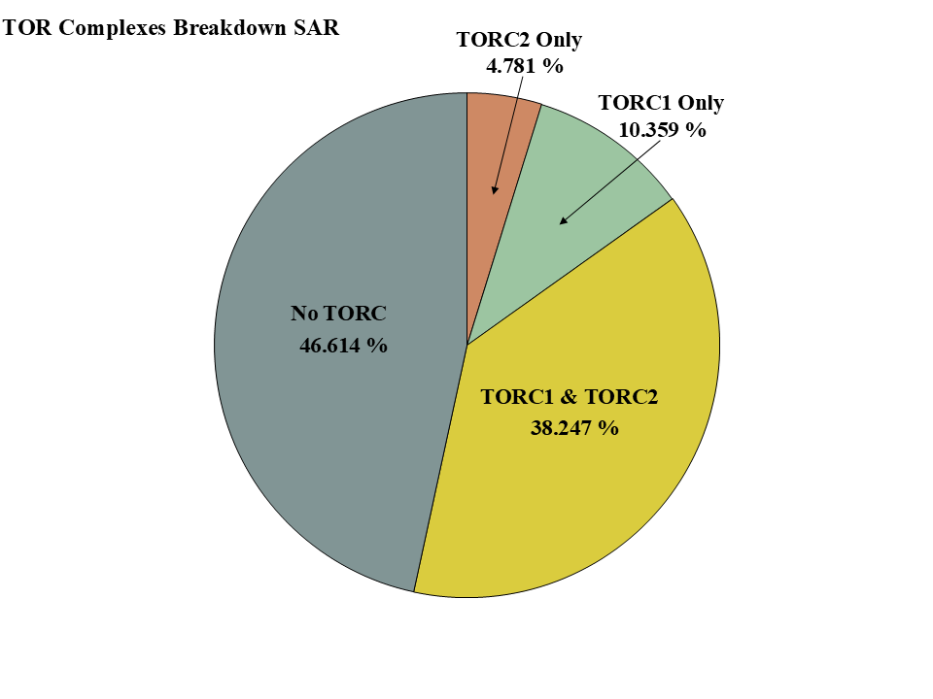
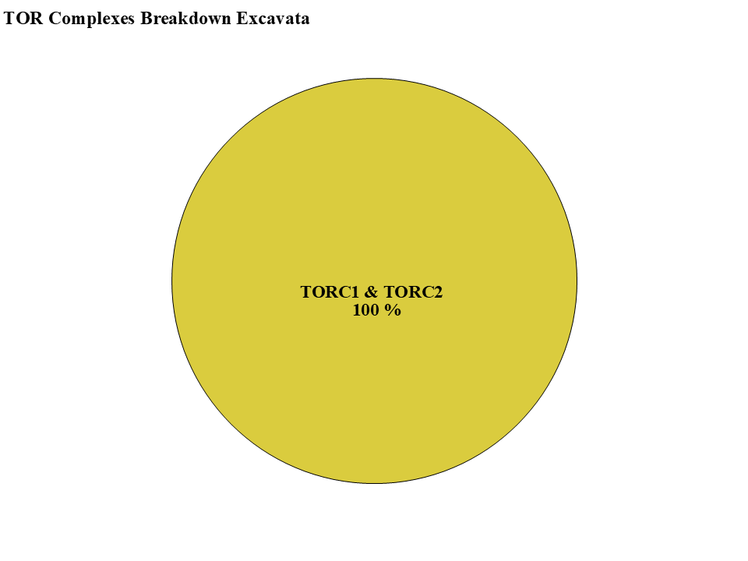
Figure 4
-TOR-
-LST8-
-RAPTOR-
-RICTOR-
-SIN1-

Slide 5
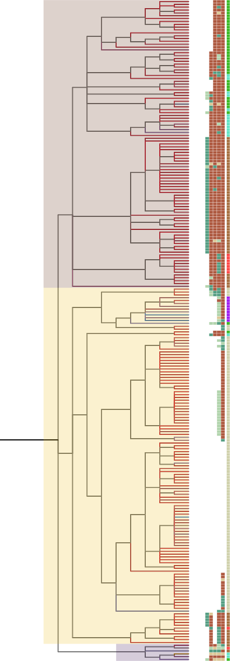
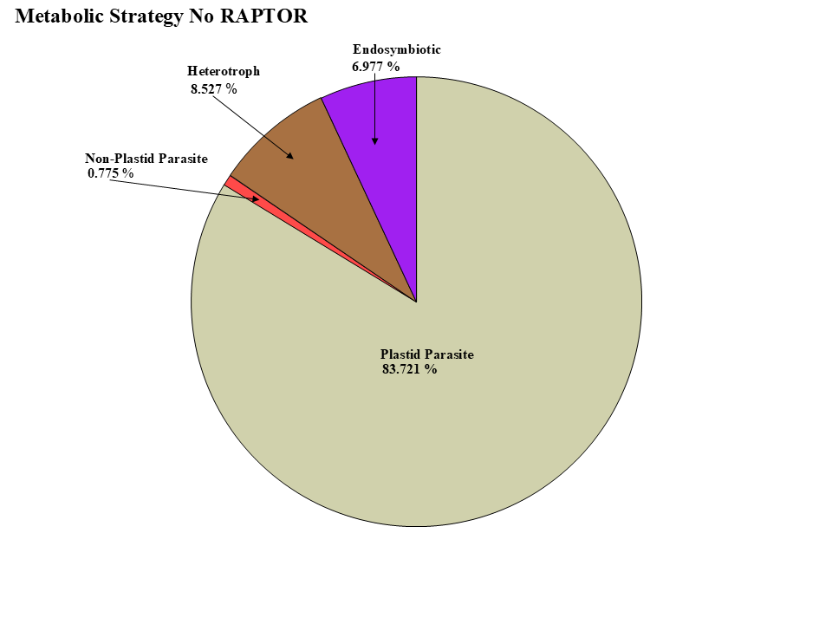
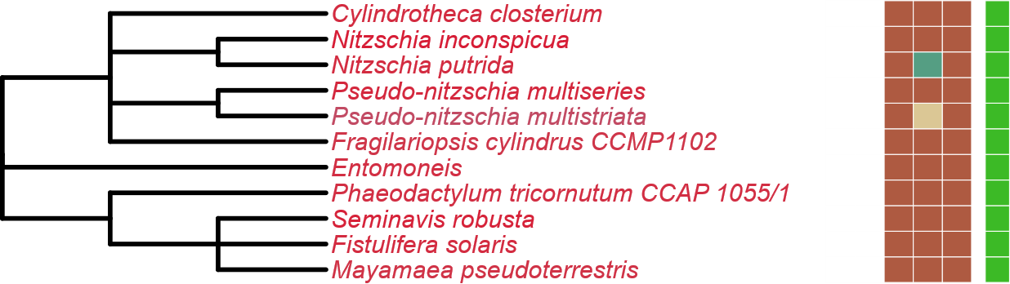
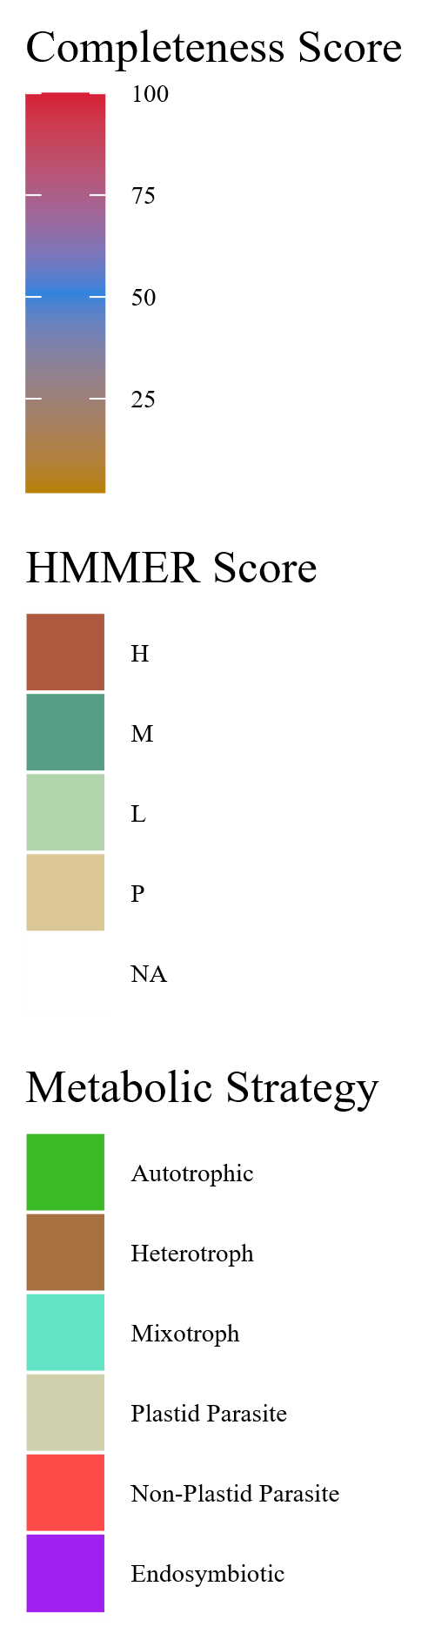
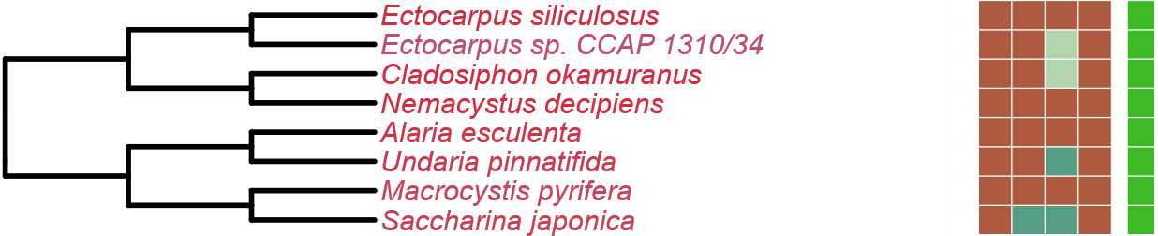
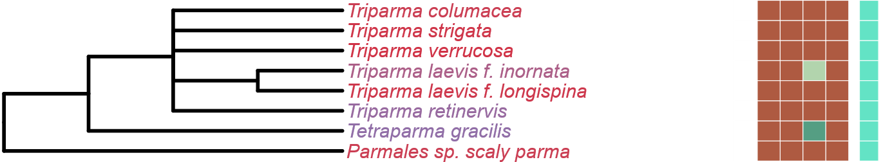
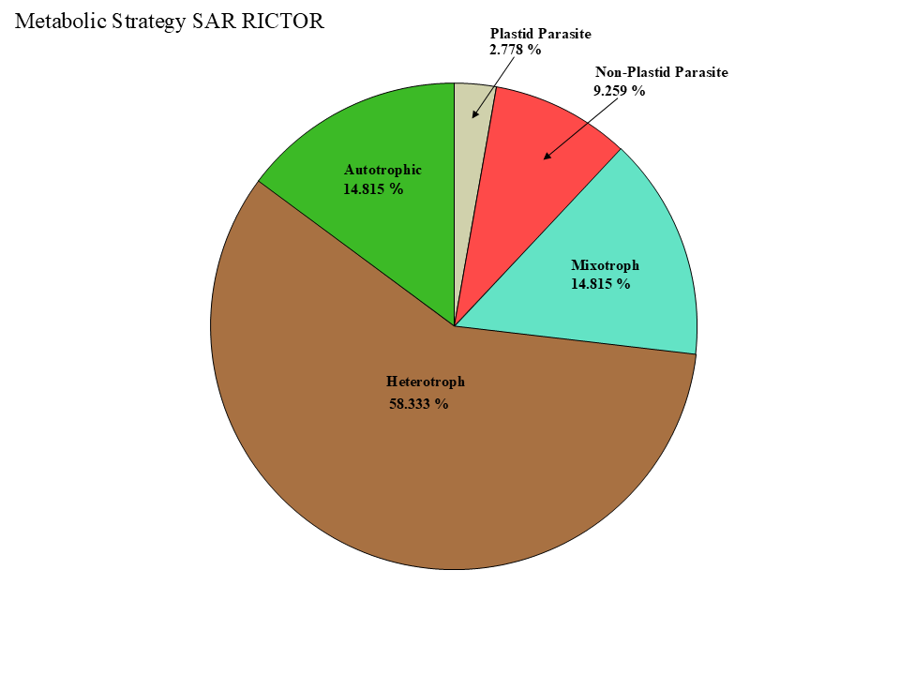
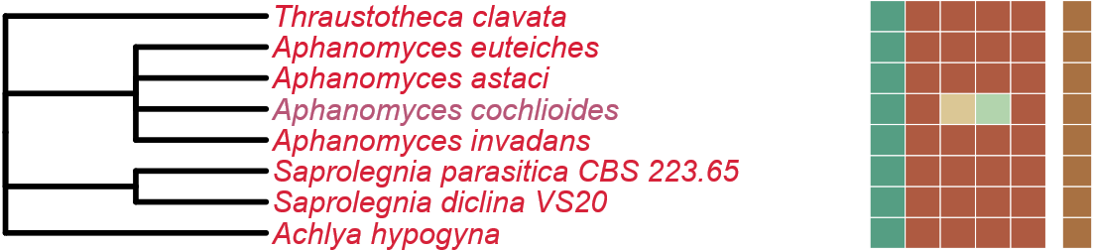
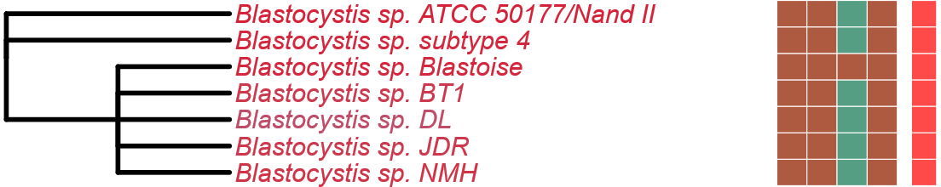
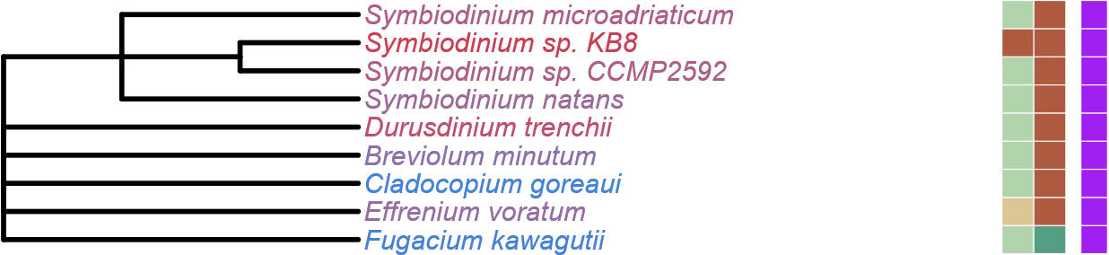
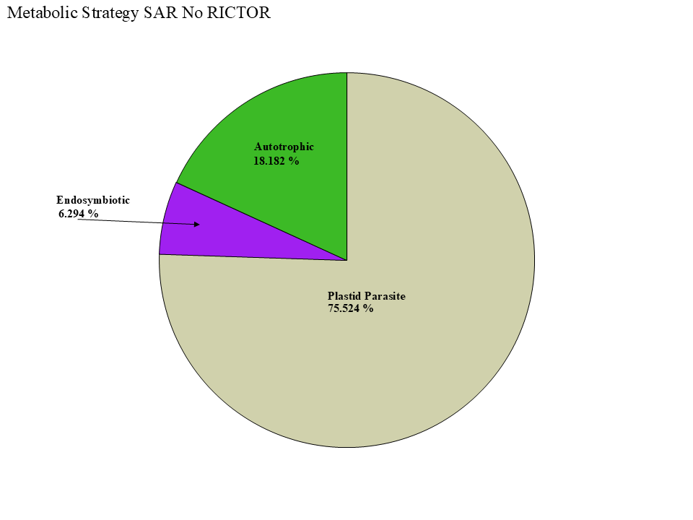
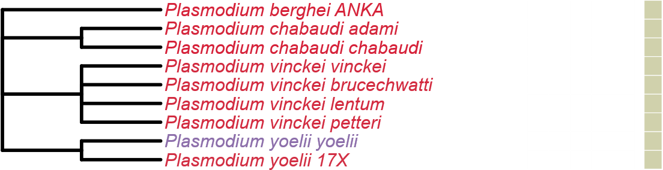
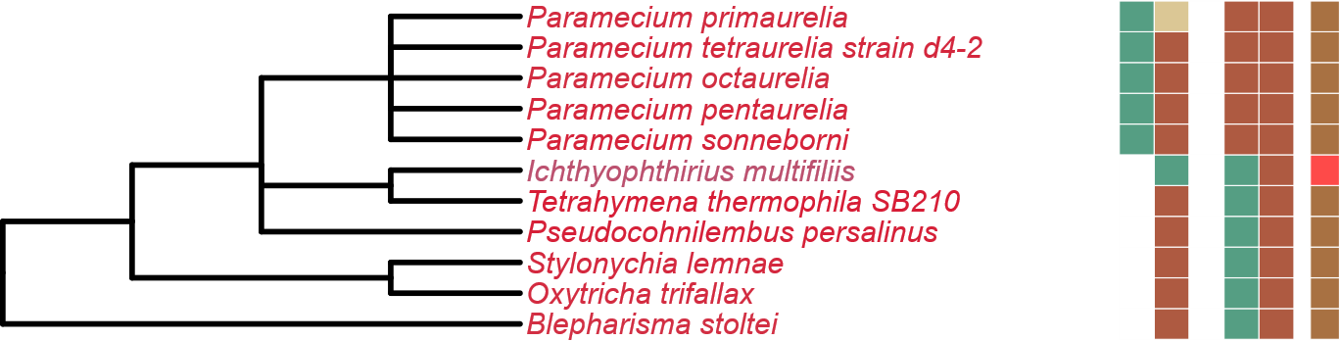
Figure 5
LST8
RICTOR
RAPTOR
SIN1
TOR
Stramenopiles
Alveolata
Rhizaria

Slide 6
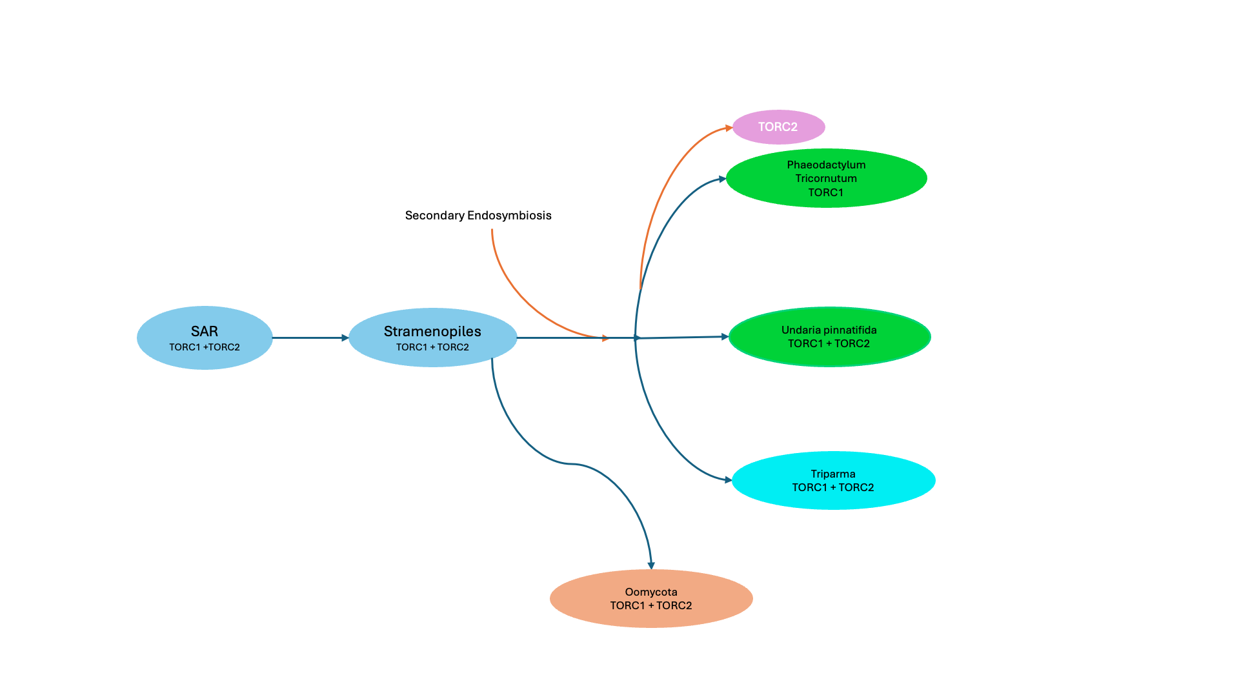
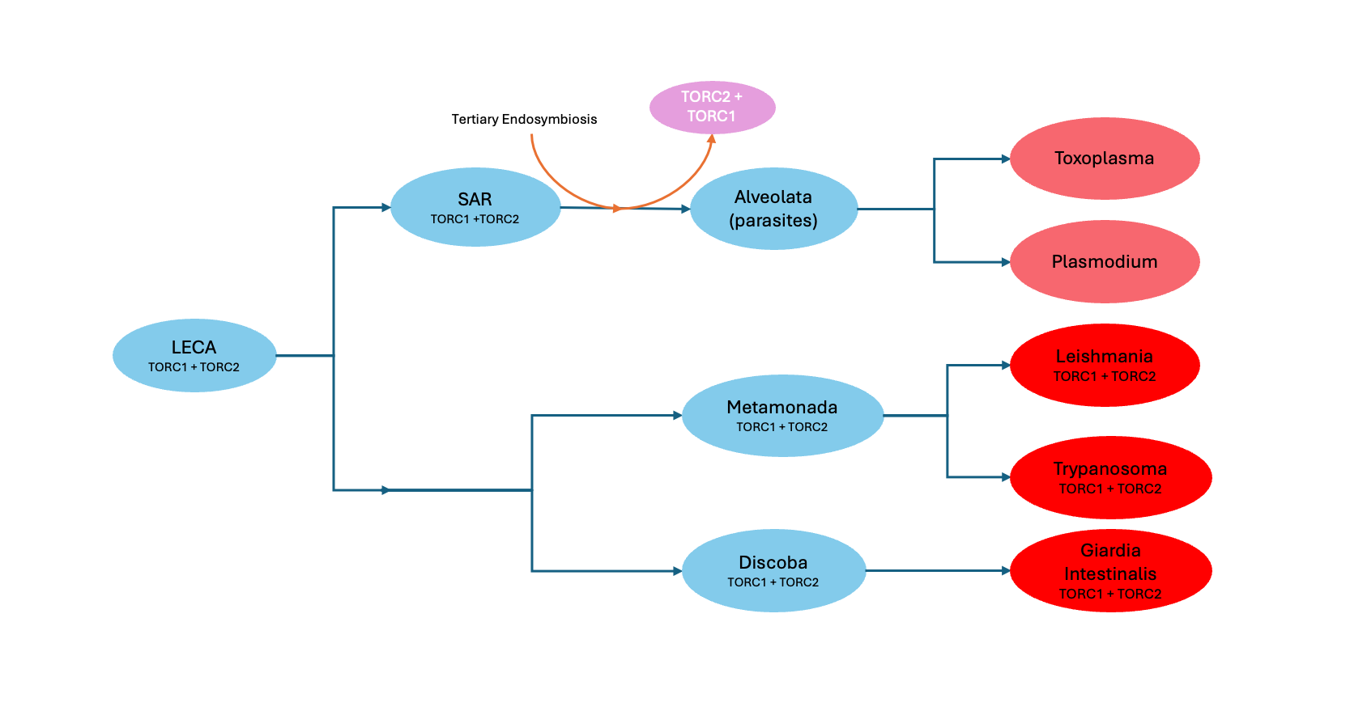
Figure 6
LECA
TORC1 +TORC2
Primary Endosymbiosis
TORC2
Archaeplastida
TORC1
Chlorophyta
TORC1
Streptophyta
TORC1
Rhodophyta
TORC1

Slide 7
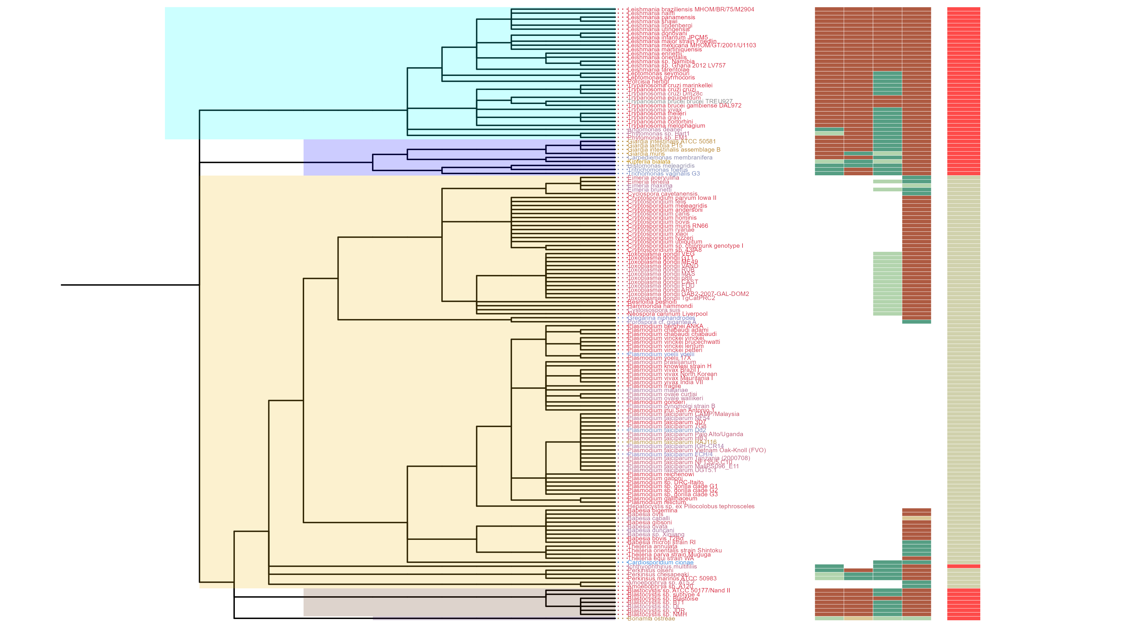
Figure 6
SIN1
RICTOR
RAPTOR
LST8
TOR
Discoba
Metamonada
Alveolata
Rhizaria
Stramenopiles

Slide 8
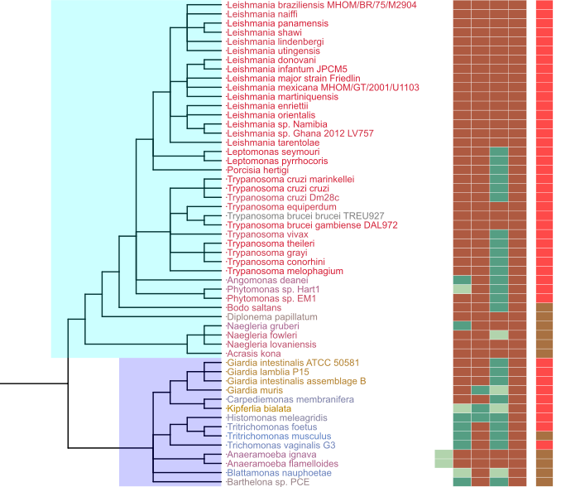
Figure 7
Metabolic Strategy
SIN1
RICTOR
RAPTOR
LST8
TOR
Discoba
TORC2
Archaeplastida
TORC1
LECA
TORC1
TORC2
Excavates
TORC1
TORC2
Discoba
TORC1
TORC2
Metamonada
Metamonada
TORC1
TORC2

Slide 9
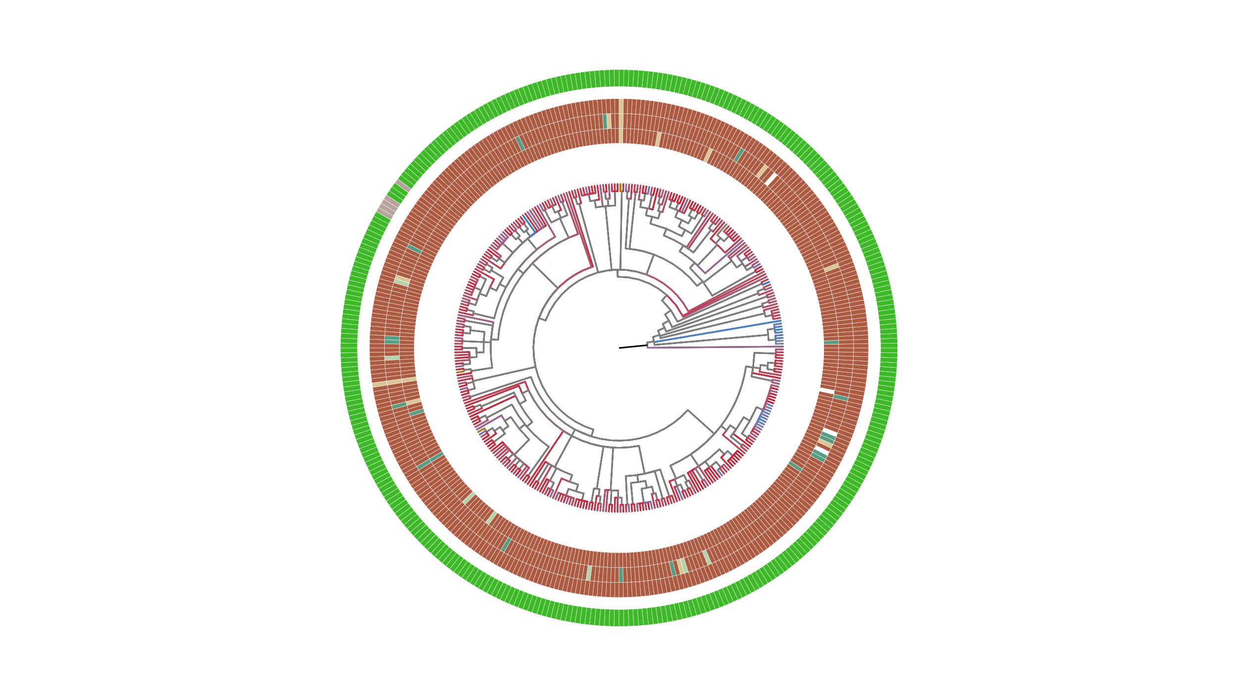
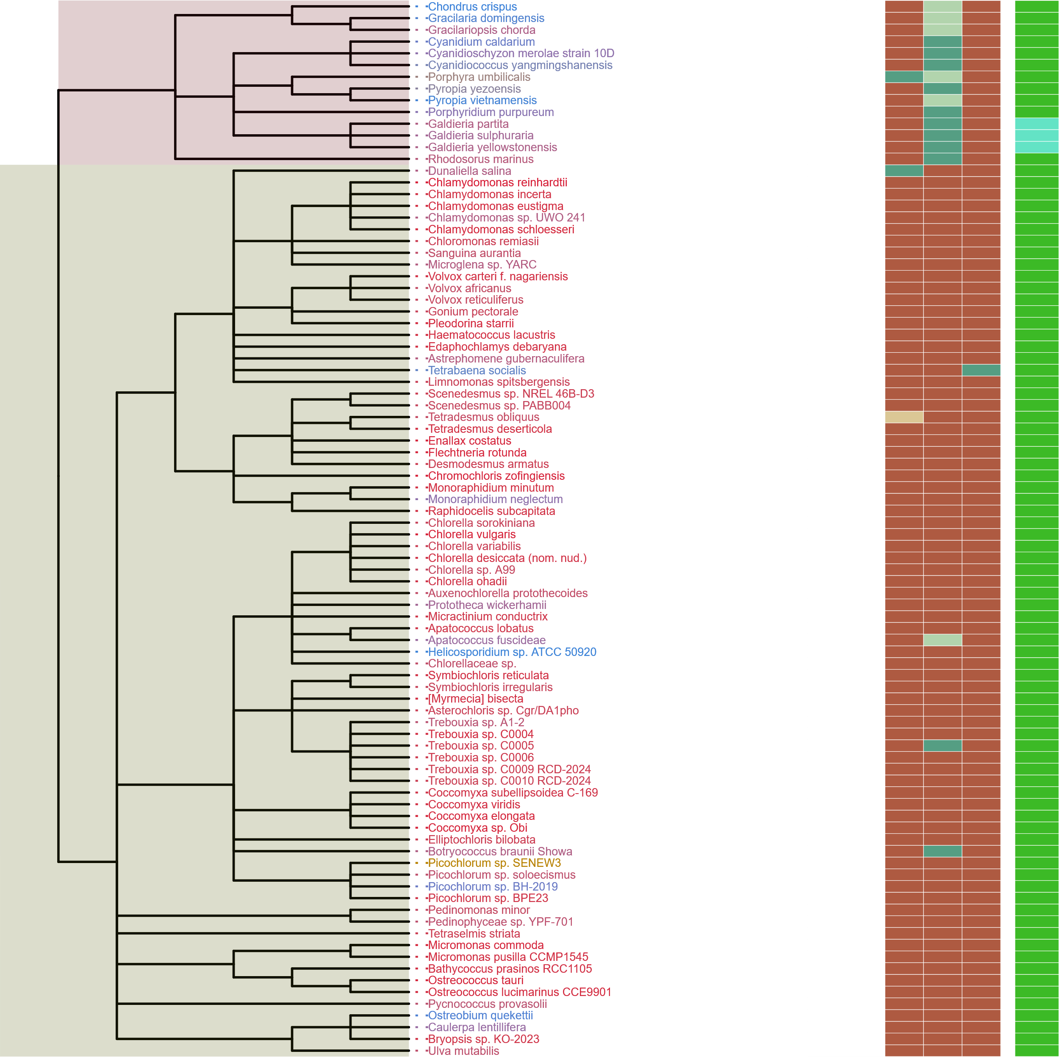
Figure 8
Metabolic Strategy
SIN1
RICTOR
RAPTOR
LST8
TOR
Streptophyta
Rhodophyta
Chlorophyta
Rhodophyta
TORC1
TORC2
Archaeplastida
Chlorophyta
TORC1
TORC1
Streptophyta
LECA
TORC1
TORC1
TORC2
Excavates,SAR,Opisthokonta,etc
TORC1
TORC2

Slide 10
ARCHIVED BELOW

Slide 11
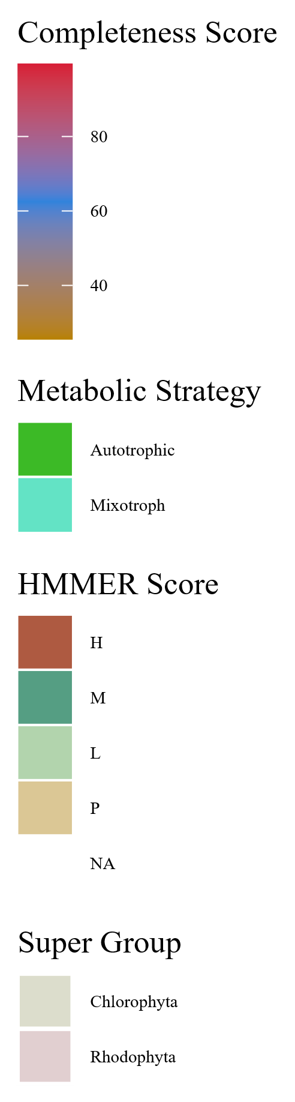
Streptophyta
Metabolic Strategy
SIN1
RICTOR
RAPTOR
LST8
TOR
Rhodophyta
Rhodophyta
TORC2
Chlorophyta
Archaeplastida
Chlorophyta
TORC1
Streptophyta
LECA
TORC1
TORC2
Excavates,SAR,Opisthokonta
TORC1
TORC2

Slide 12
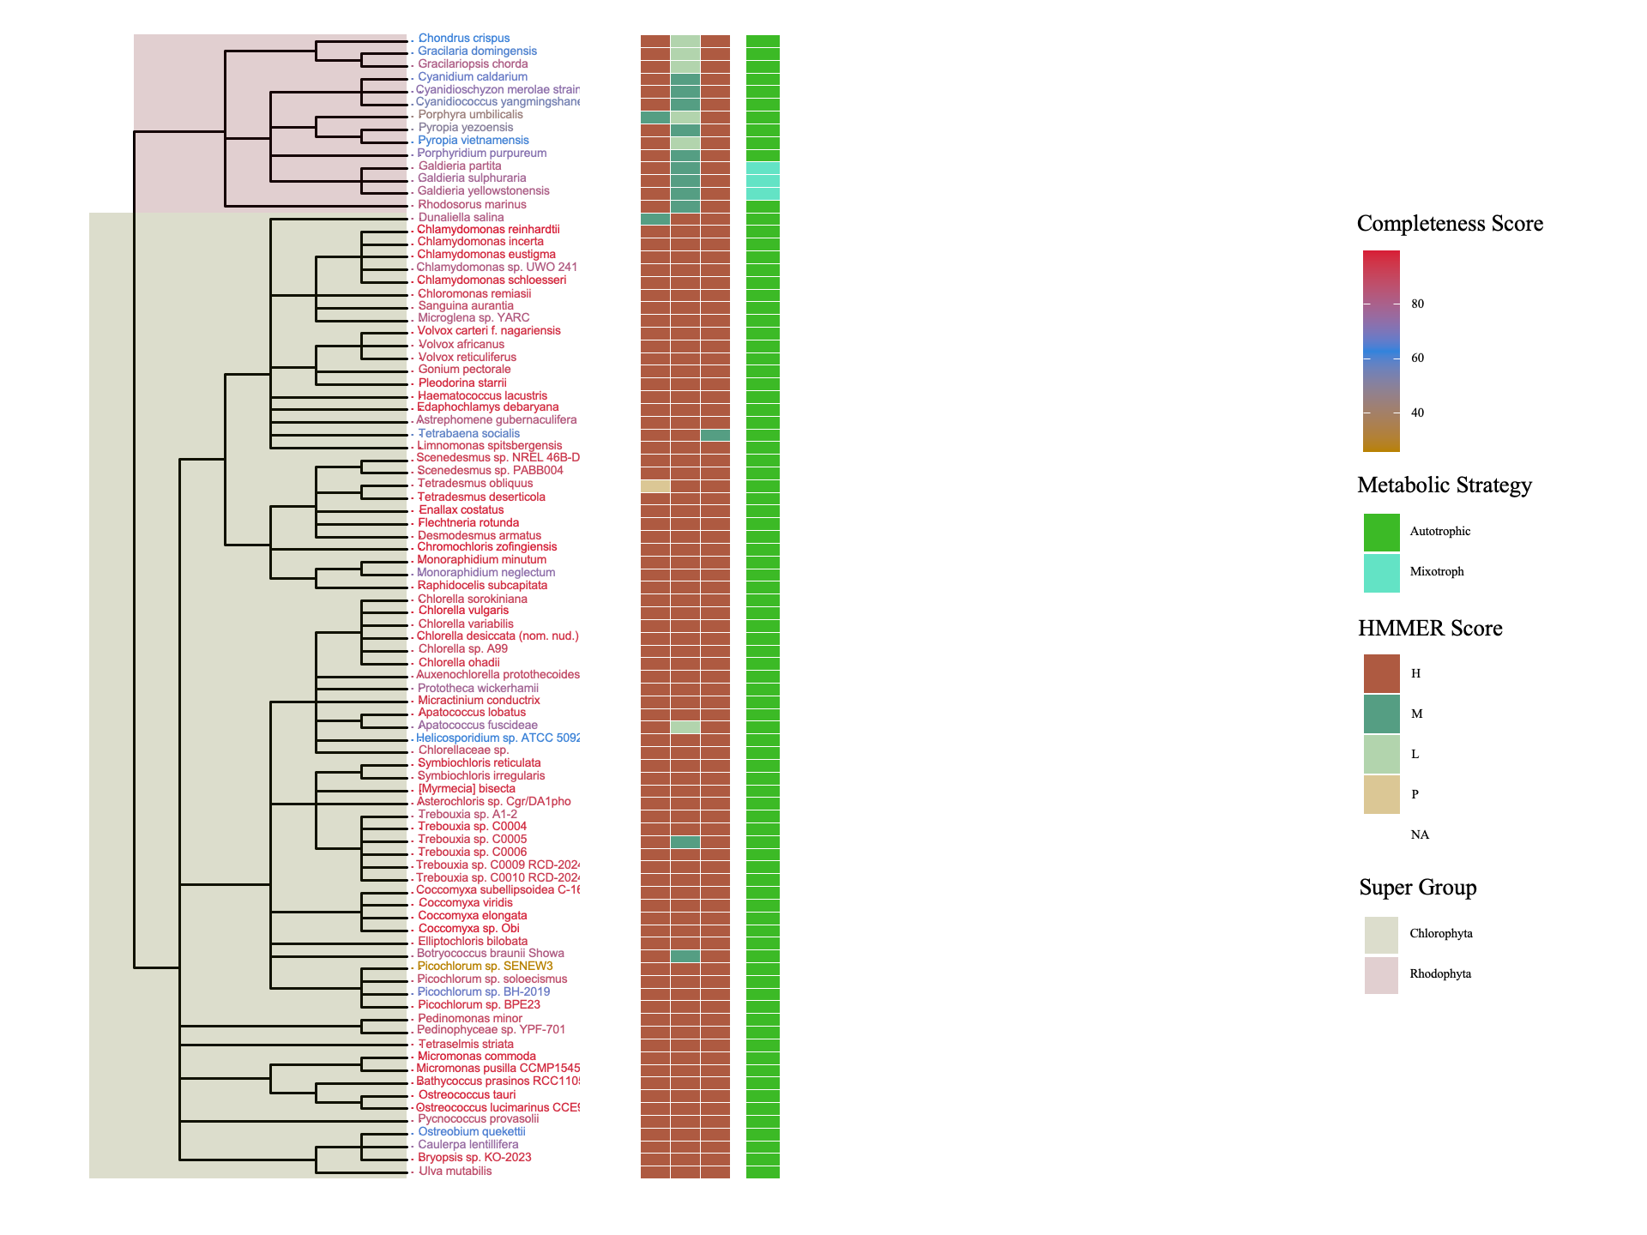
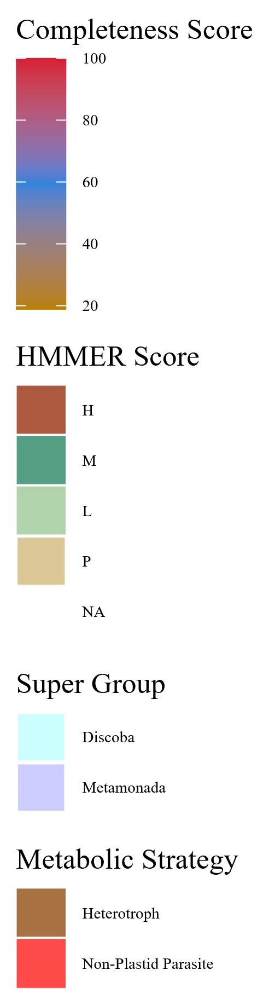
Figure 7
Metabolic Strategy
Metabolic Strategy
SIN1
RICTOR
LST8
RAPTOR
SIN1
TOR
RICTOR
RAPTOR
LST8
TOR
Rhodophyta
Discoba
Chlorophyta
Metamonada

Slide 13
Rhodophyta
TORC1
TORC2
Archaeplastida
Chlorophyta
TORC1
TORC1
Streptophyta
LECA
TORC1
TORC1
TORC2
Excavates,SAR,Opisthokonta,etc
TORC1
TORC2

Slide 14


Slide 15



Figure 6

Slide 16
Figure 1
MSA
Phylogenetic Tree(s)
Final Images,
Pattern Loss Detection
Genome information from NCBI/JGI
BUSCO/HMMER/BLAST
Combined Dataframes
Graphs/Plots/Tables
Trophic Strategy from literature
SRA/DIAMOND

Slide 17
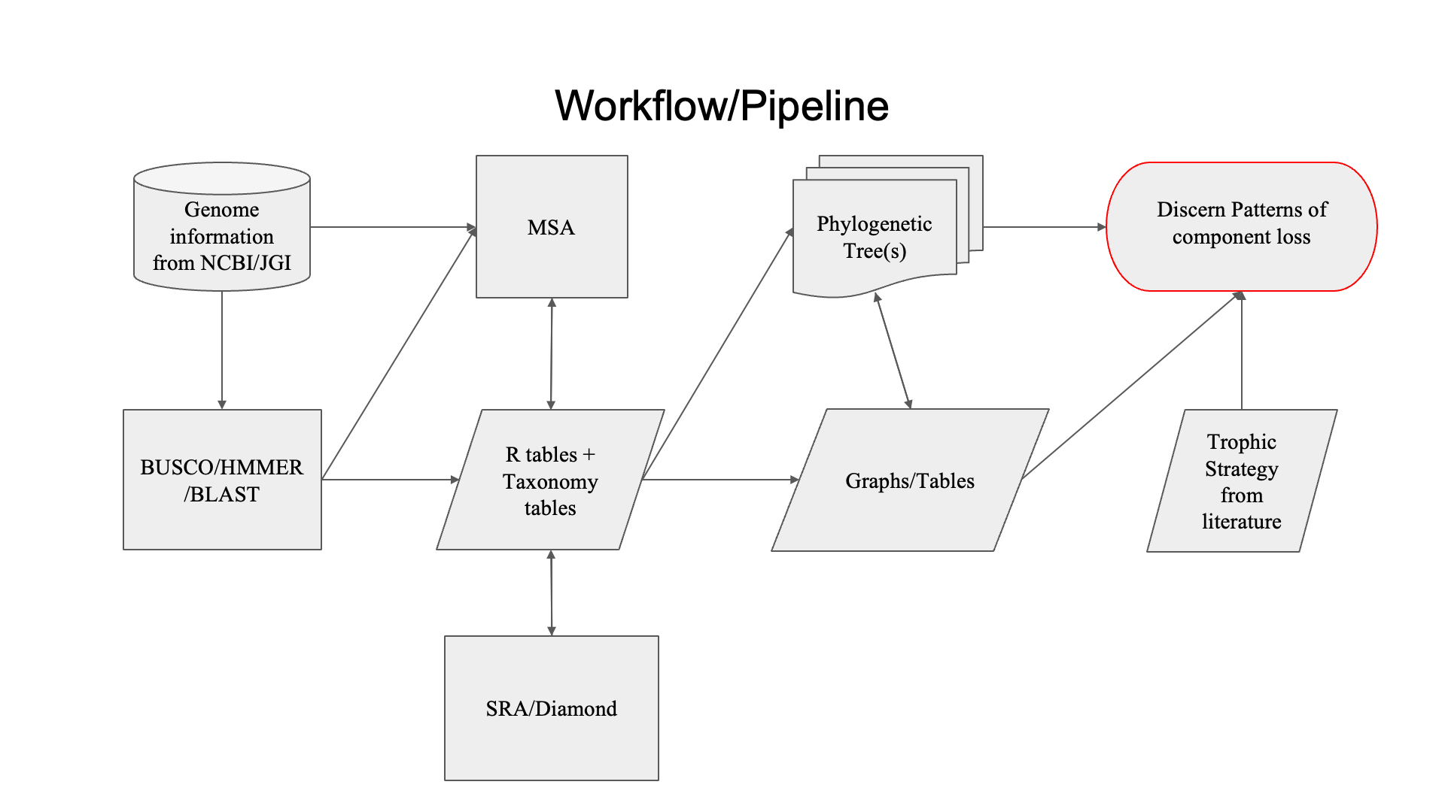
Figure 1

Slide 18






Figure 3
1
RasGEF
Domain5
1694
RICTORN
RICTORM
RICTOR Phosphorylation
Reference
High
Medium
Low
1
HEAT
ARM Repeats
1353
RAPTORN
ARM Repeats
WD-40 Repeats
Reference
High
Medium

Slide 19
Figure 3
1
1694
RICTORN
RICTORM
RasGEF
Domain5
RICTOR Phosphorylation
ARM Repeats
Reference
High
Medium
Low
1
1353
RAPTORN
ARM Repeats
HEAT
ARM Repeats
WD-40 Repeats
Reference
High
Medium

Slide 20
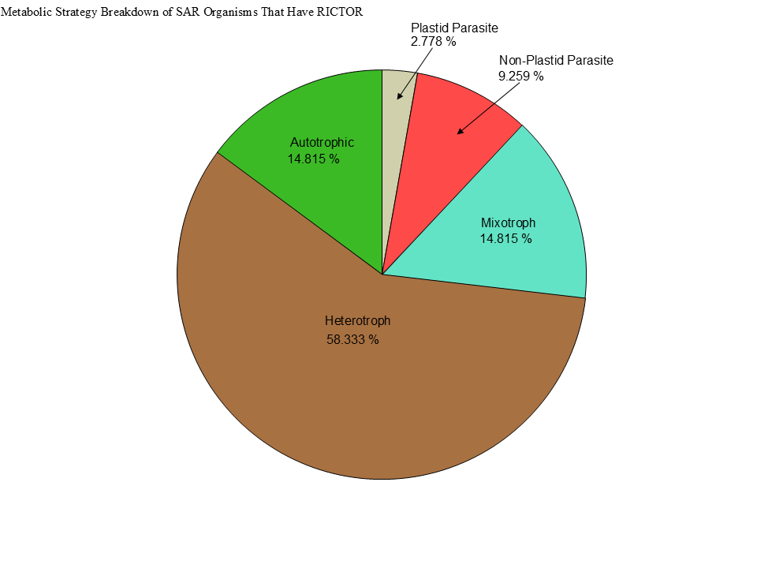
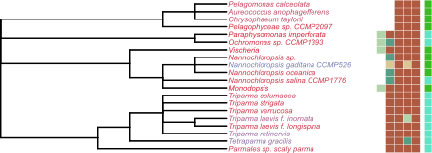
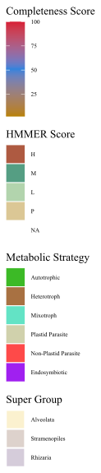
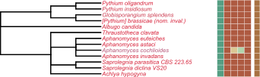
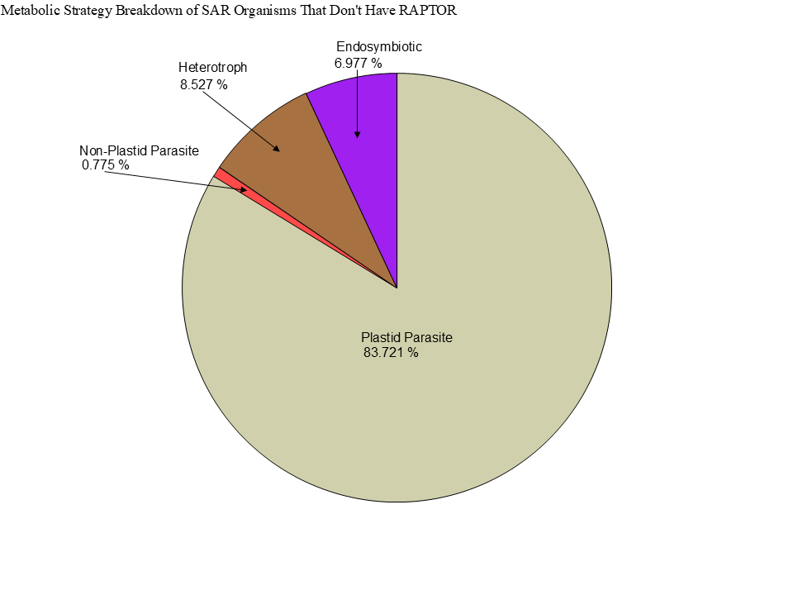
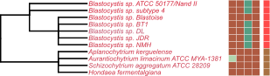
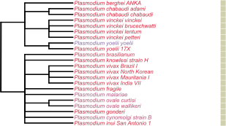

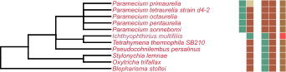
Metabolic Strategy
LST8
RICTOR
RAPTOR
SIN1
TOR
Stramenopiles
Alveolata
Rhizaria

Slide 22
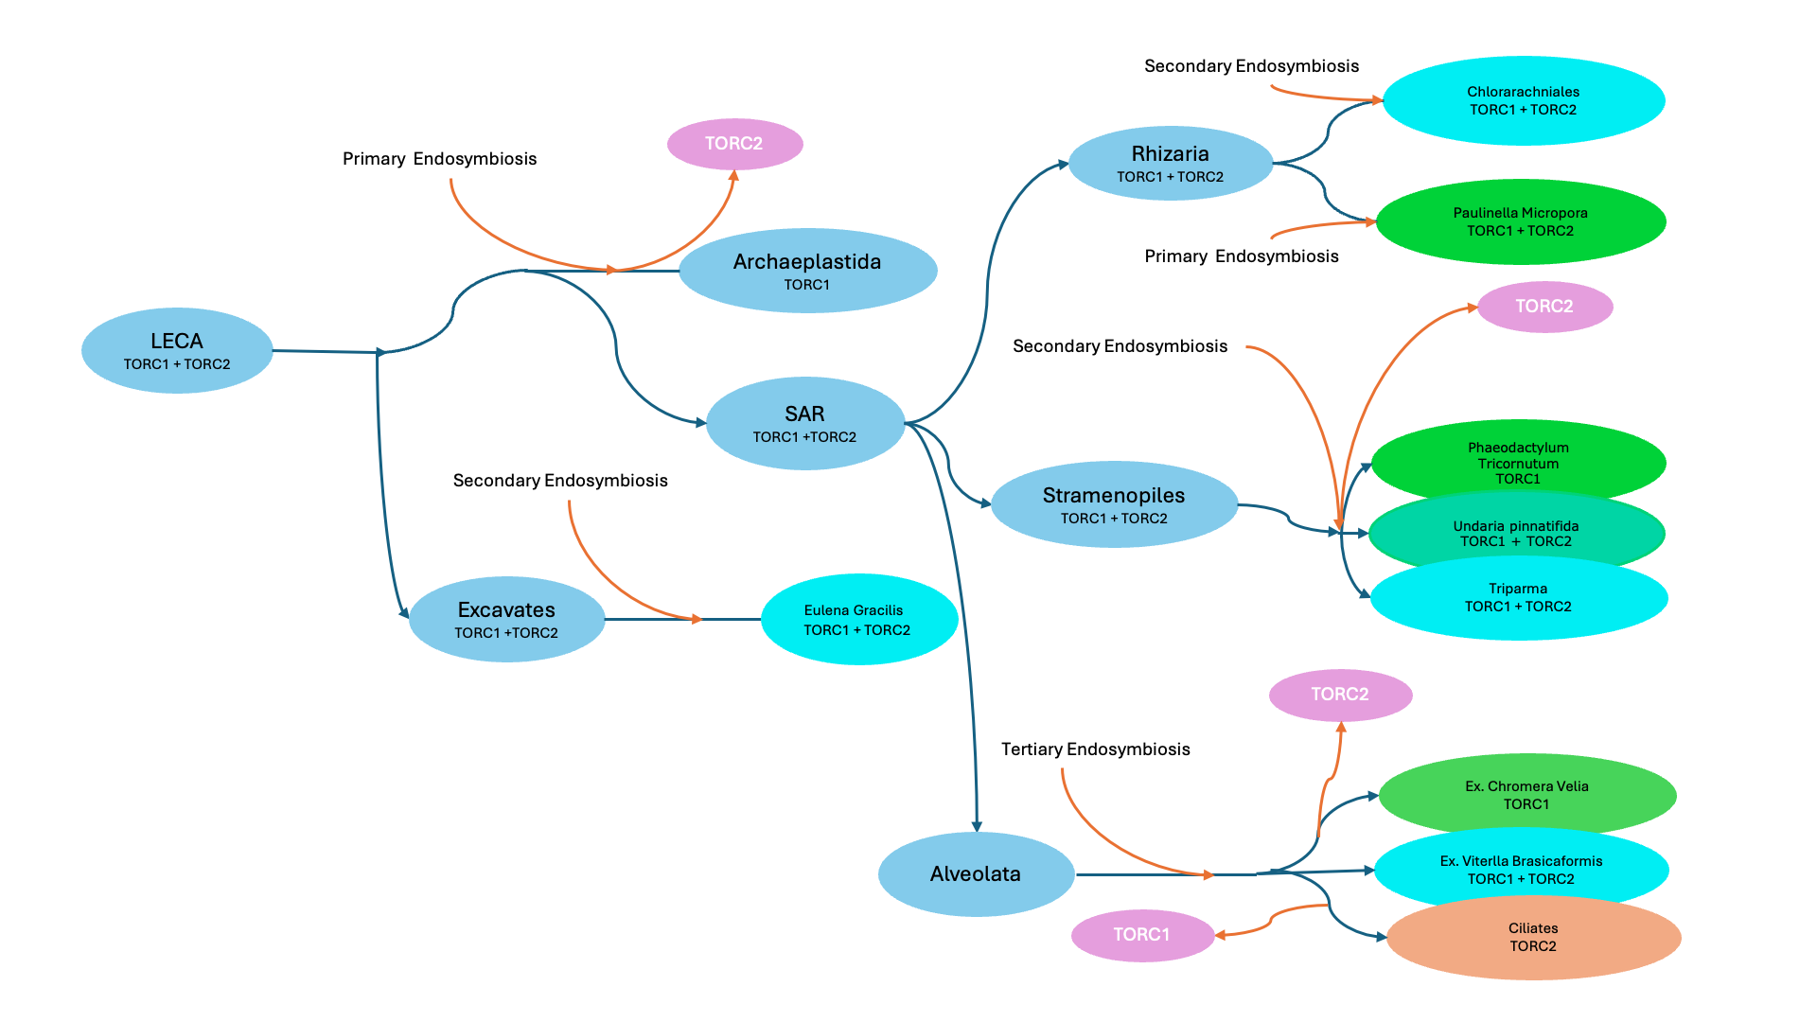

Slide 23
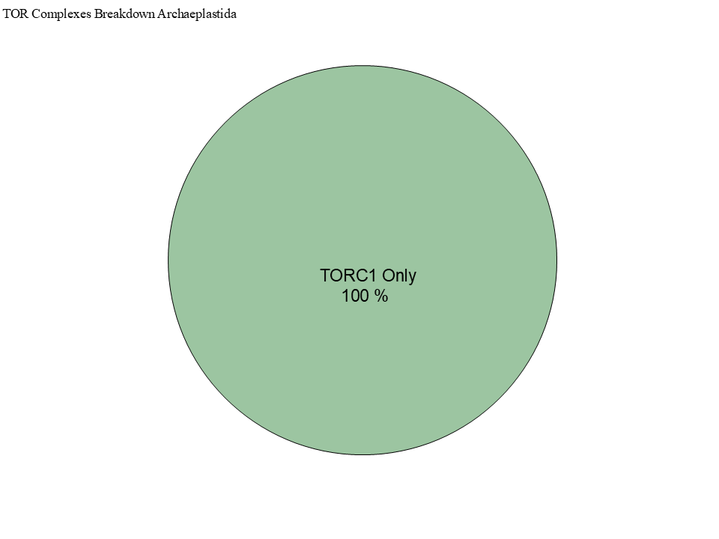
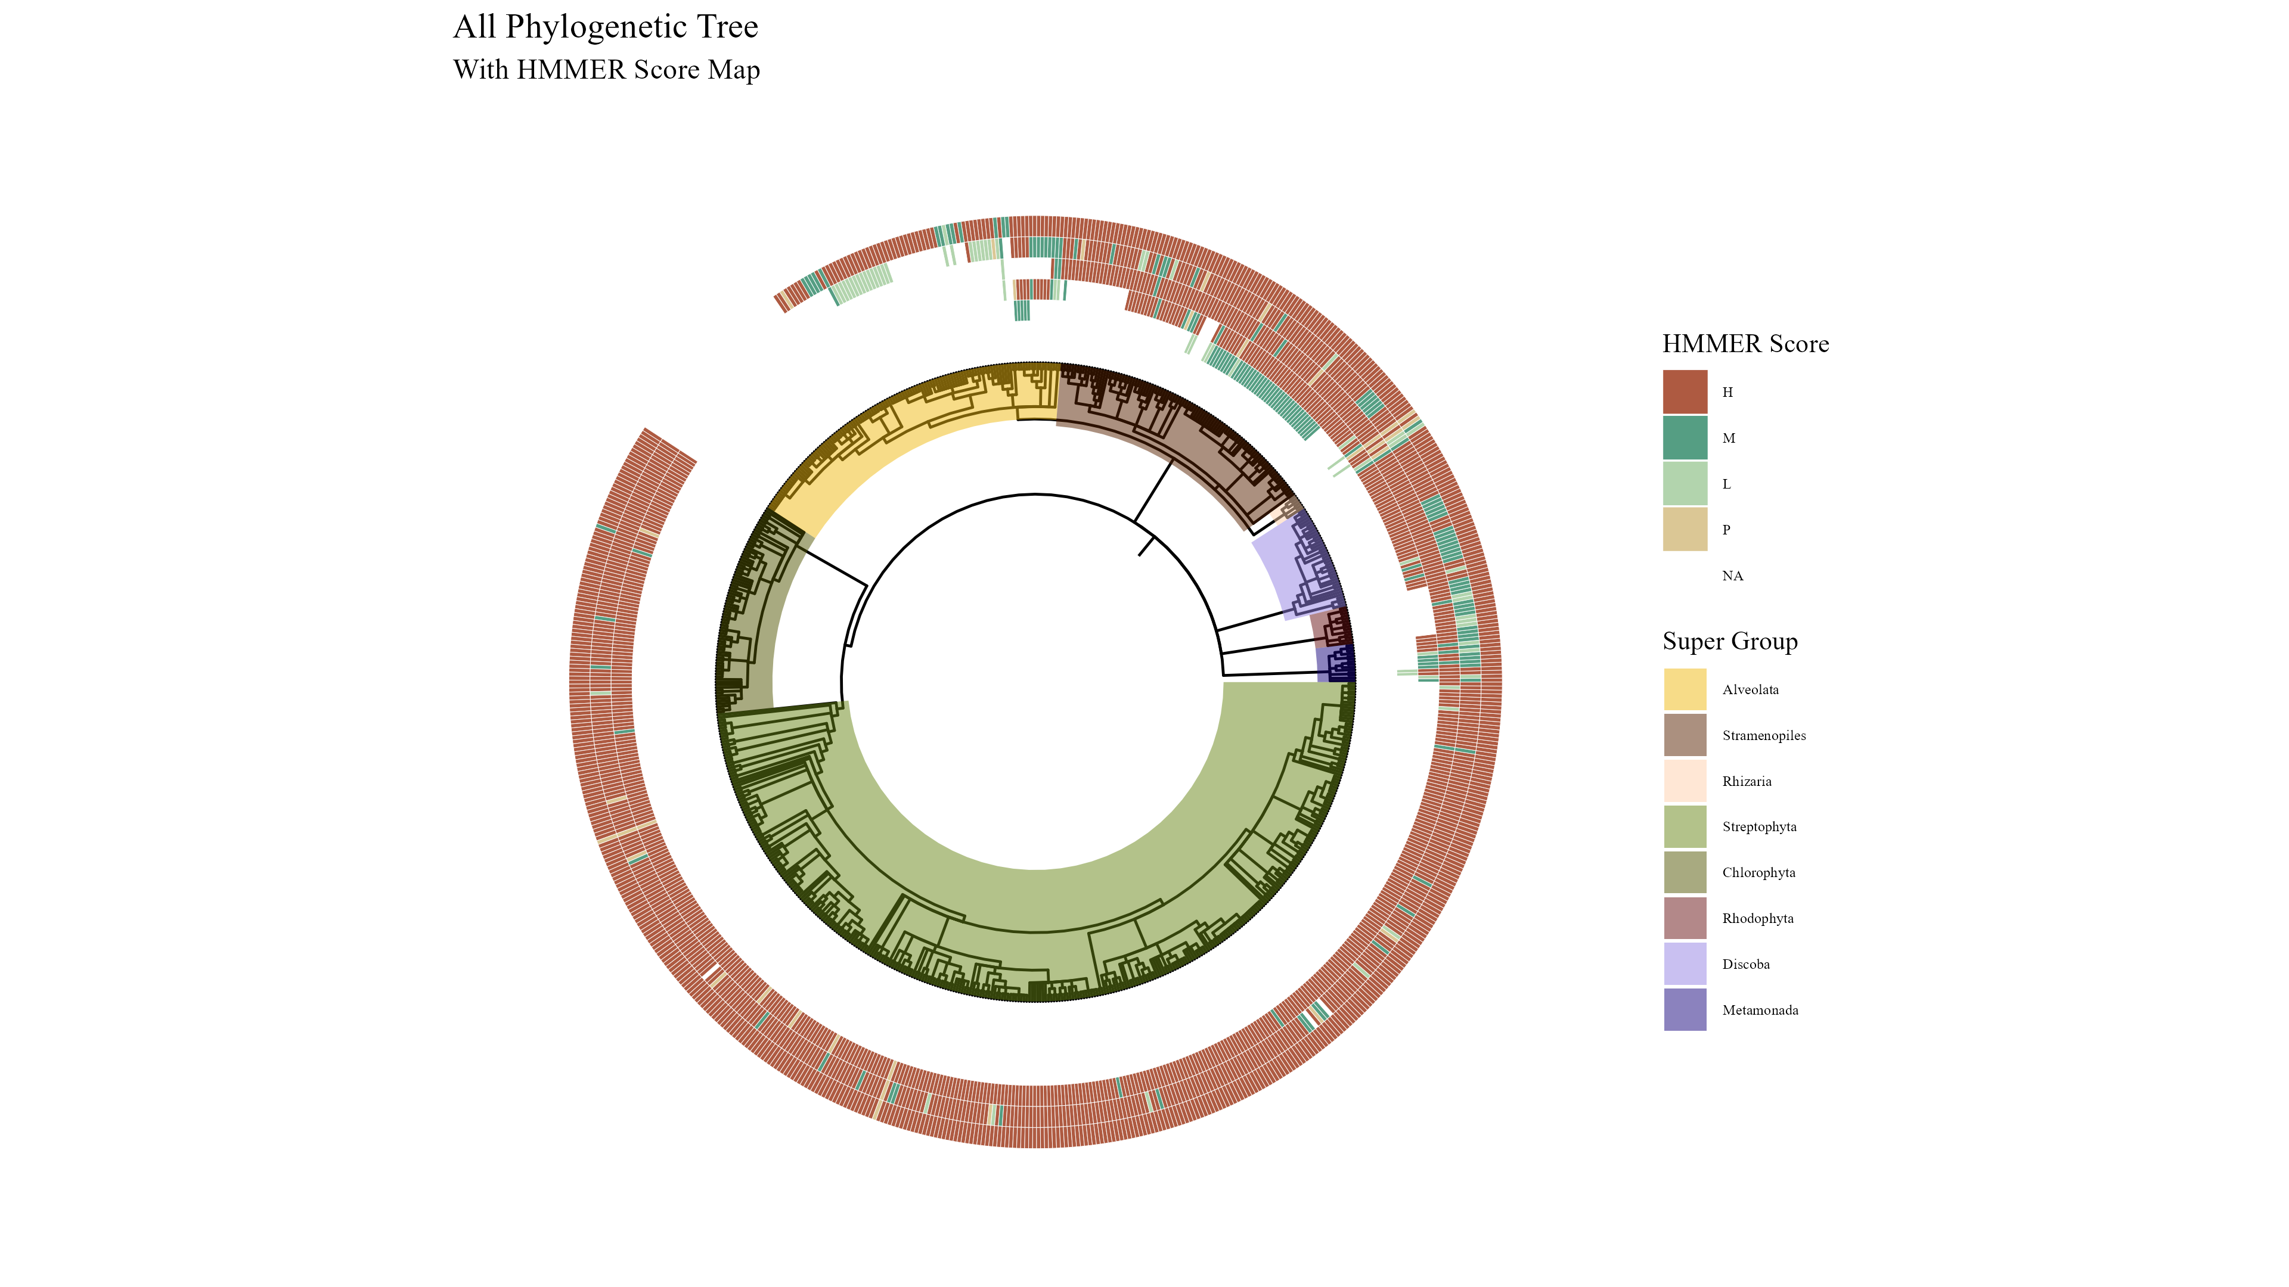
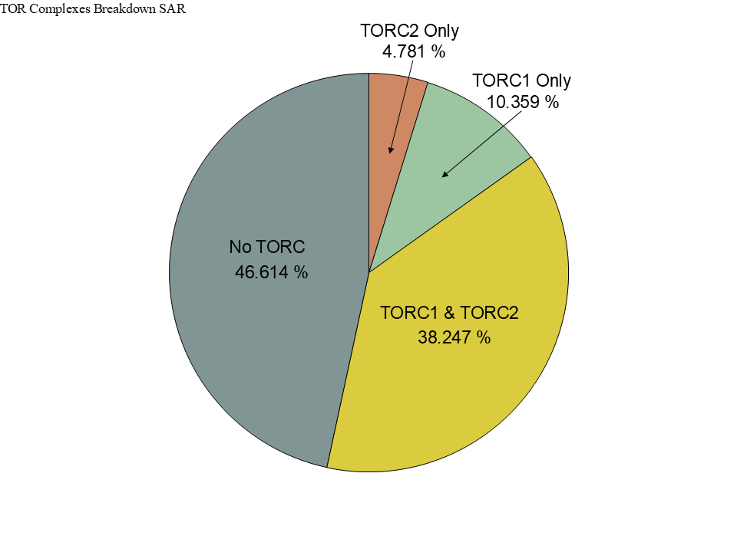
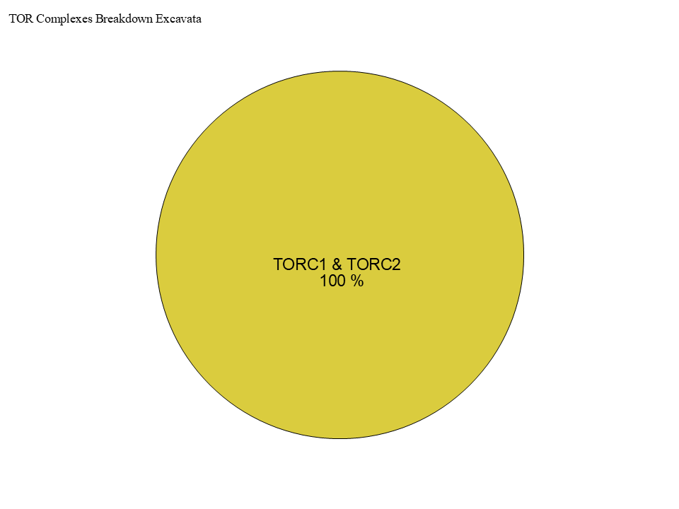
Figure 3
TOR
LST8
RAPTOR
RICTOR
SIN1

Slide 24
Streptophyta
Secondary Endosymbiosis
Rhodophyta
Primary Endosymbiosis
TORC2
Chlorophyta
Chlorarachniales
TORC1 + TORC2
Rhizaria
TORC1 + TORC2
Primary Endosymbiosis
Archaeplastida
TORC1
LECA
TORC1 + TORC2
Paulinella Micropora
TORC1 + TORC2
SAR
TORC1 +TORC2
Secondary Endosymbiosis
TORC2
Stramenopiles TORC1 + TORC2
Brown Algae
TORC1
Secondary Endosymbiosis
Excavates
TORC1 +TORC2
Tertiary Endosymbiosis
TORC2 + TORC1
Eulena Gracilis
TORC1 + TORC2
Alveolata

Slide 25
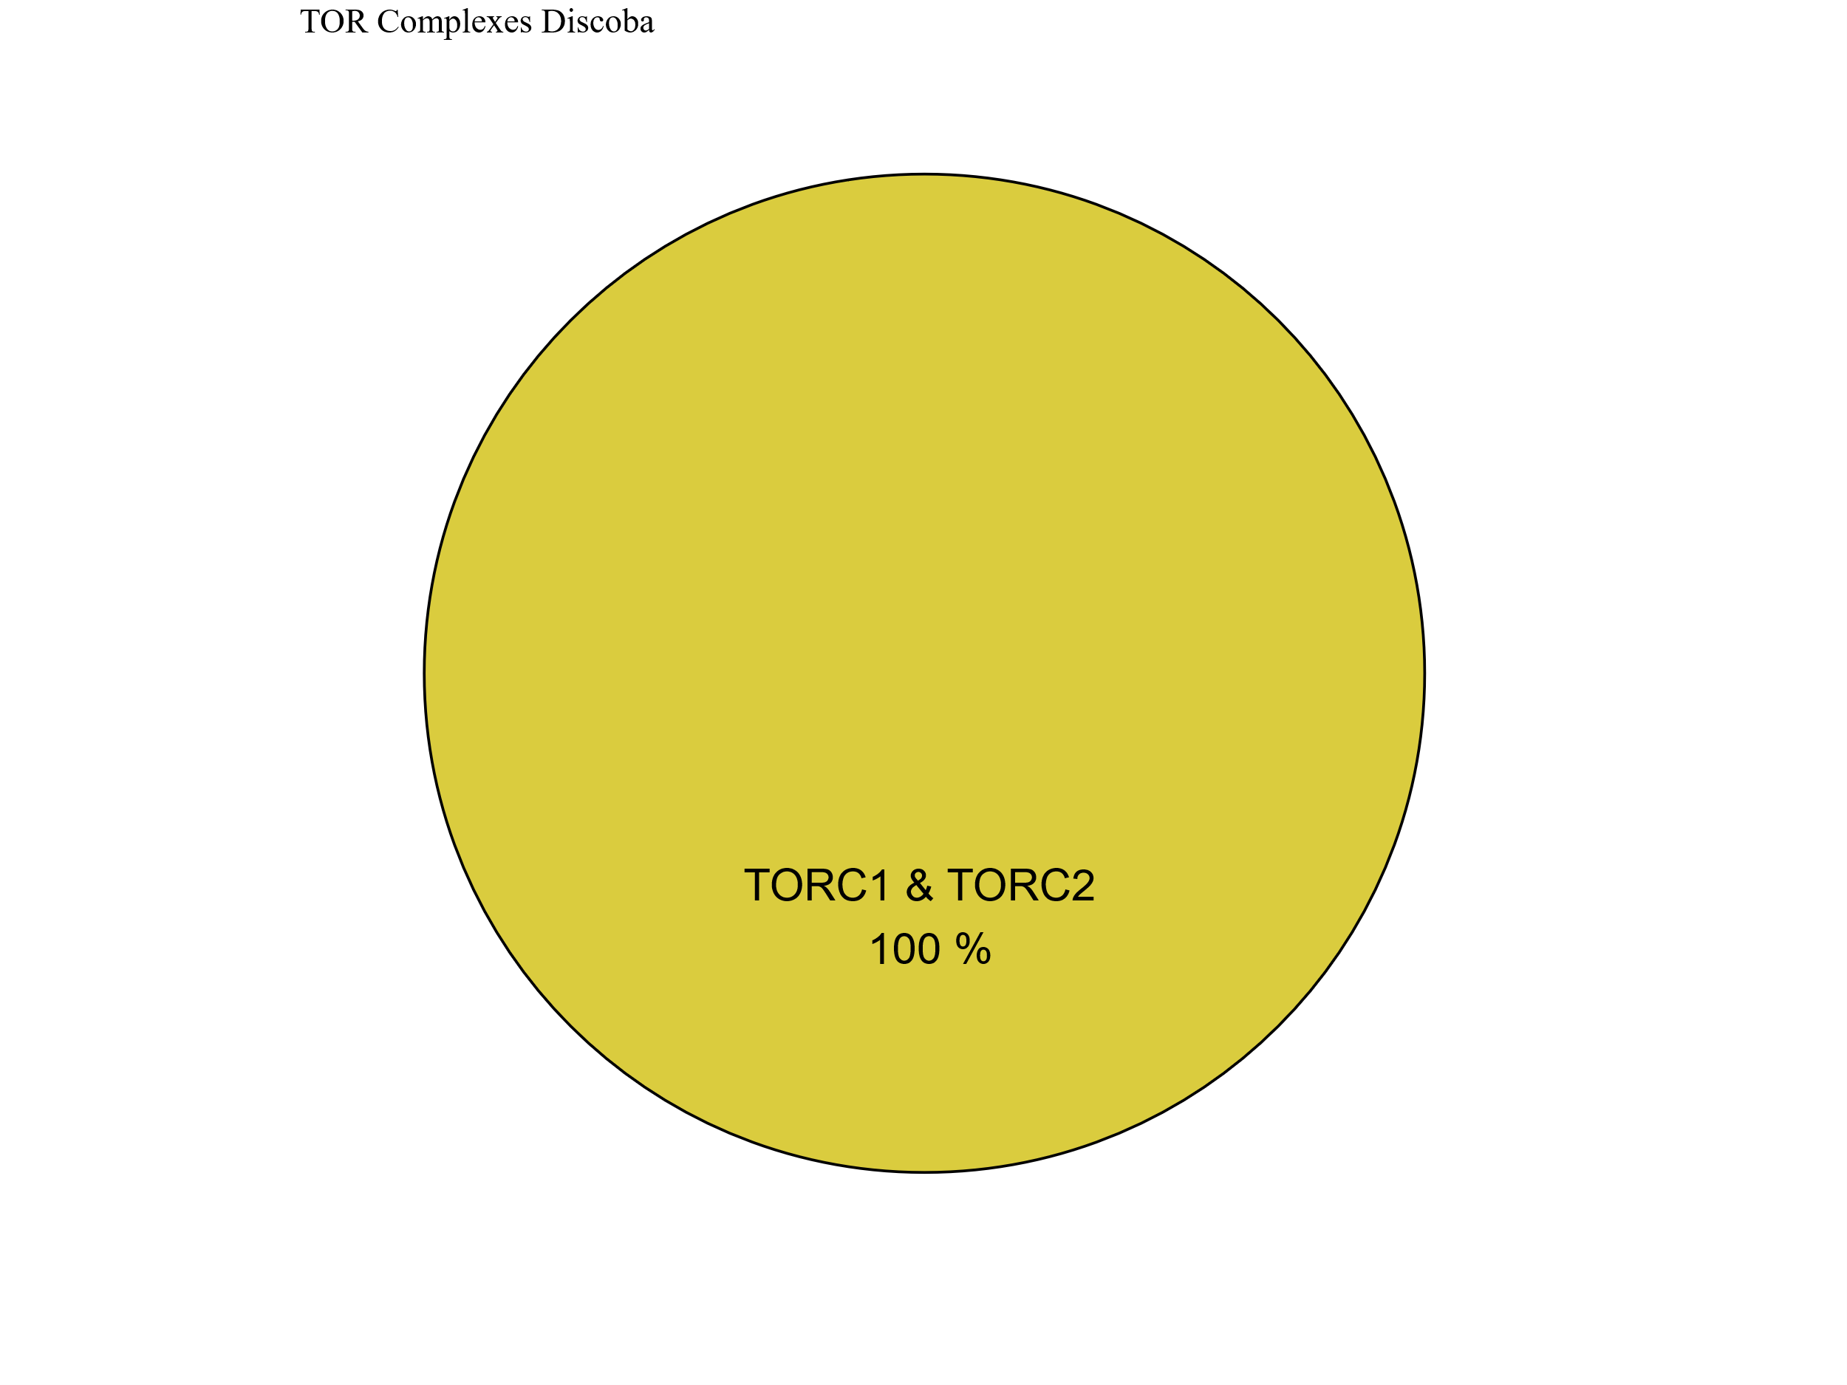
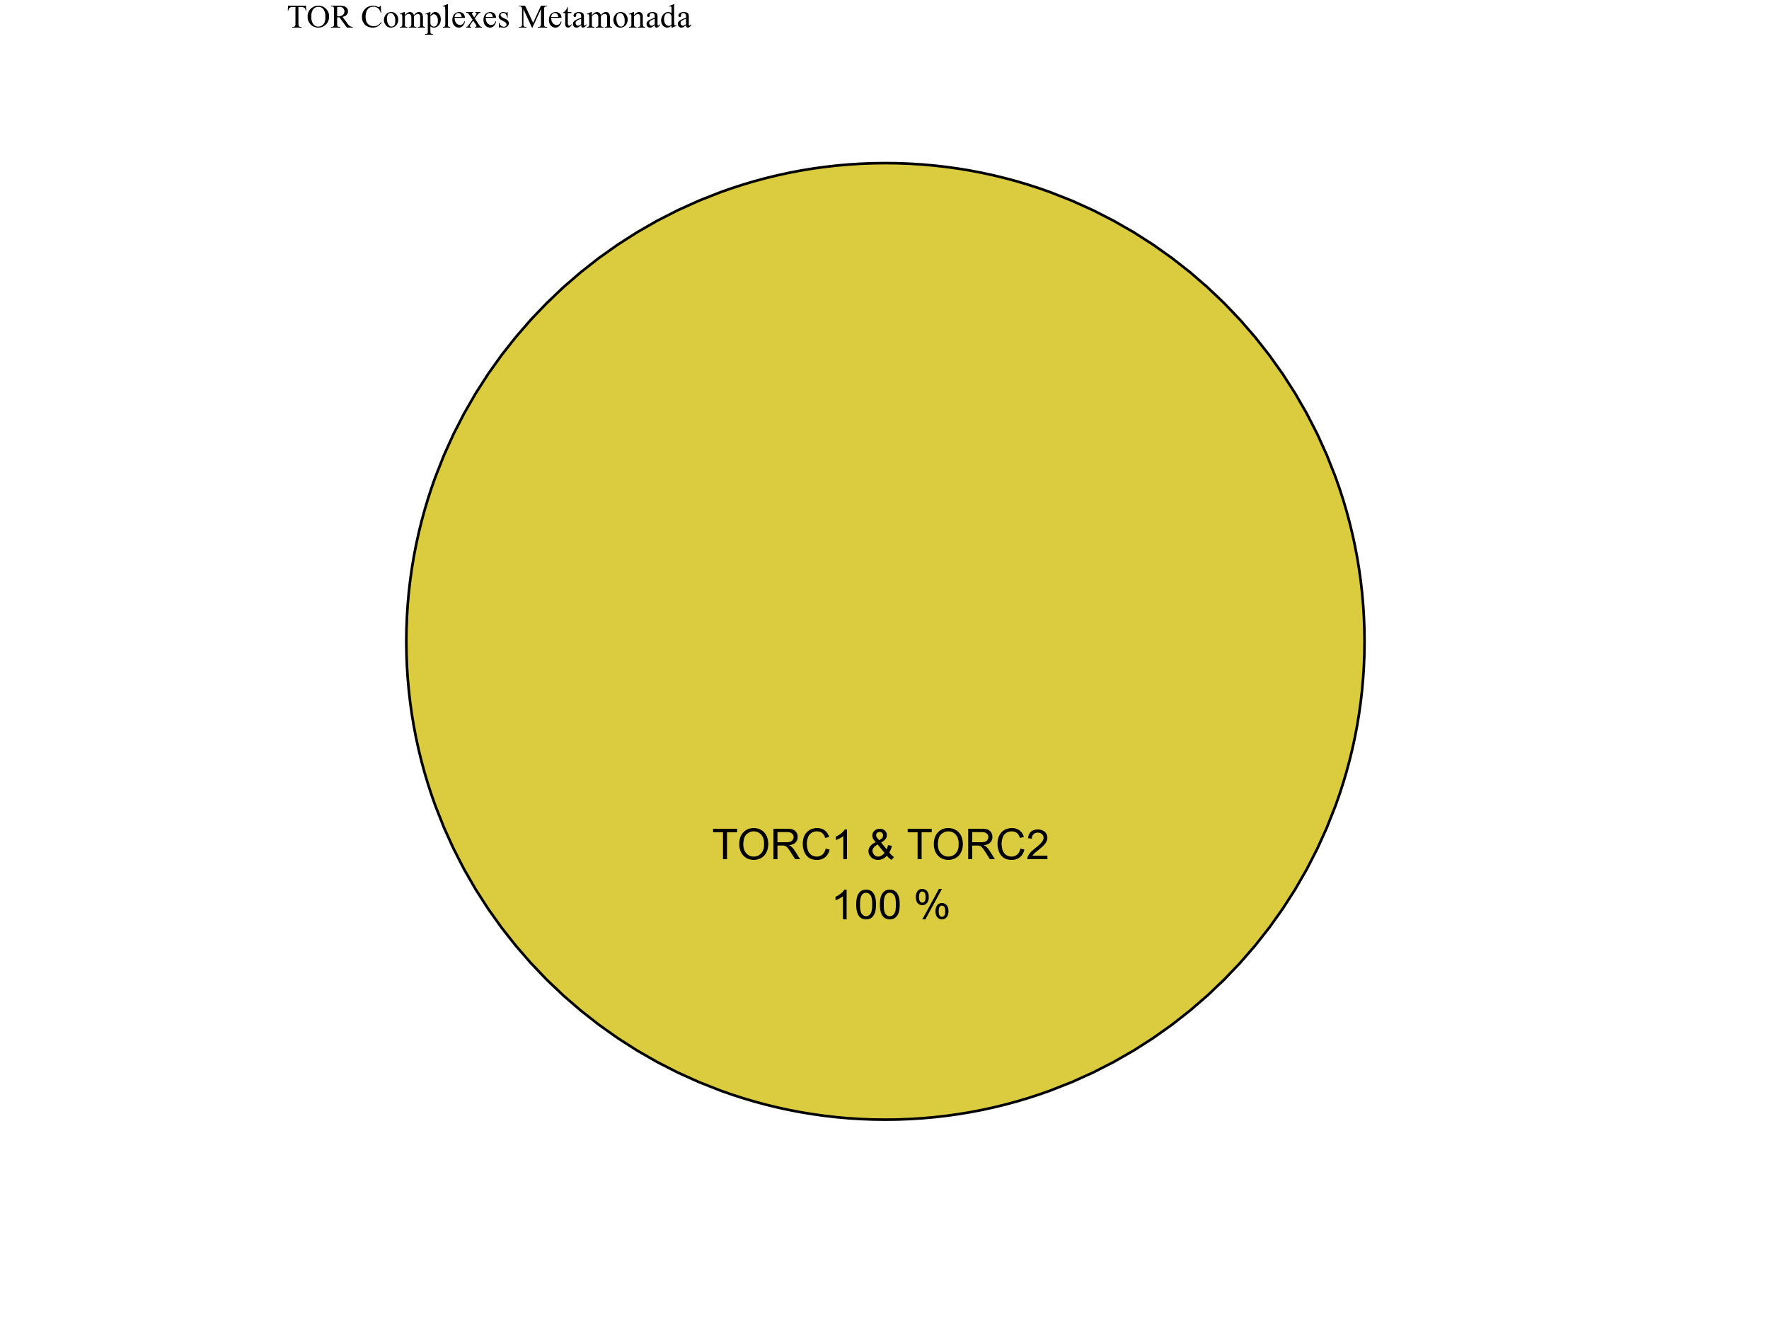
Figure 7
Metabolic Strategy
SIN1
RICTOR
RAPTOR
LST8
TOR
Discoba
Metamonada

Slide 26



Metabolic Strategy
Streptophyta
SIN1
RICTOR
RAPTOR
LST8
TOR
Rhodophyta
Chlorophyta

Slide 27



Slide 28





Figure 6

Slide 29


Figure 6

Slide 30



Figure 6

Slide 31
Figure 5

Slide 32
Workflow/Pipeline
NCBI/JGI Genomic Information
MSA
Phylogenetic Tree(s)
Results/TOR Complex Patterns
BUSCO/HMMER/BLAST
R Tables & Taxonomy Tables
Graphs/Data Table
SRA /Diamond Alignment
Notes:
We need to add a start point. Have something that asks the question; what organisms have TORC2 Components and TORC1 Components?

Slide 33
SARs Gain of Plastids:
Losses of TOR Complexes
Rhodophyta Endosymbiosis
Phaeodactylum tricornutum
TORC2 Lost
Macrocystis pyrifera
Stramenopila
Nannochloropsis gaditana
Phytophthora sojae
Expected Heterotrophic Ancestor
TORC1 & TORC2 Present
Stramenopile Endosymbiosis
Polarella glaciallis
Vitrella Brassicaformis
Alveolata
Plasmodium falciparum
Tetrahymena thermophila
Alpha-Cyanobacteria Endosymbiosis
Photoautorophy Loss
Paulinella micropora
TORC1 and TORC2 Lost
Bigelowiella natans
TORC1 Lost
Rhizaria
Chlorophyta Endosymbiosis
Plasmodiophora brassicae

Slide 34
Figure 4

Slide 35


Slide 36


Figure 4

Slide 37
Phylo Trees
HMMER
ClustalO
NCBI/JGI
BLAST
Final Images
Patterns of Loss
Dataframe
BUSCO
DIAMOND
Graphs
Metabolism
Literature
Notes:
We need to add a start point. Have something that asks the question; what organisms have TORC2 Components and TORC1 Components?

Slide 38
Simplified Excavata Gain of Plastids
Chlorophyta Endosymbiosis
Euglenophyceae
Discoba
Kinetoplastea
Eutetramitia, etc.
Expected Heterotrophic Ancestor
TORC1 & TORC2 Present
Metamonada

Slide 39


Slide 40

Figure 1
Metamonada
Opisthokonta
Amoebozoa
Discoba
Rhizaria
Streptophyta
Alveolata
Stramenopila
Rhodophyta
Chlorophyta

Slide 41




Figure 7

Slide 42




Slide 43
Figure 3

Slide 44




Slide 45


Slide 46


Slide 47


Slide 48

Figure 3
TOR
LST8
RAPTOR
RICTOR
SIN1

Slide 49








Figure 2

Slide 50
Metabolic Strategy
LST8
RICTOR
RAPTOR
SIN1
TOR
Stramenopiles
Alveolata
Rhizaria

